Slide 1
POST PROCESSING OF OCCUPANCY GRID MAPS USING PERSISTENT HOMOLOGY
Ragesh Kumar Ramachandran and Spring Berman
Robotic Embedded Systems Laboratory
Autonomous collective systems Laboratory

Slide 2
Motivation
How to exploit the structure of the environment to refine an occupancy grid map.
The common idea is to construct a "Maximum A Posterior" map.
The process computes the map with maximum probability based on the grid occupancy probability.
We present an alternative approach that is based on techniques from topological data analysis (TDA), which exploit the definite structure of real-world environments.

Slide 3
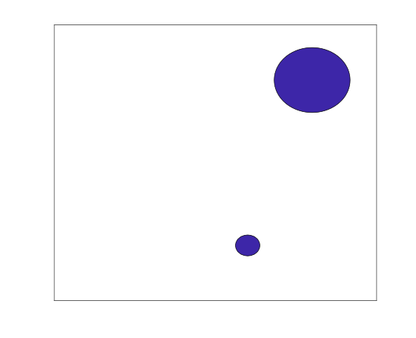
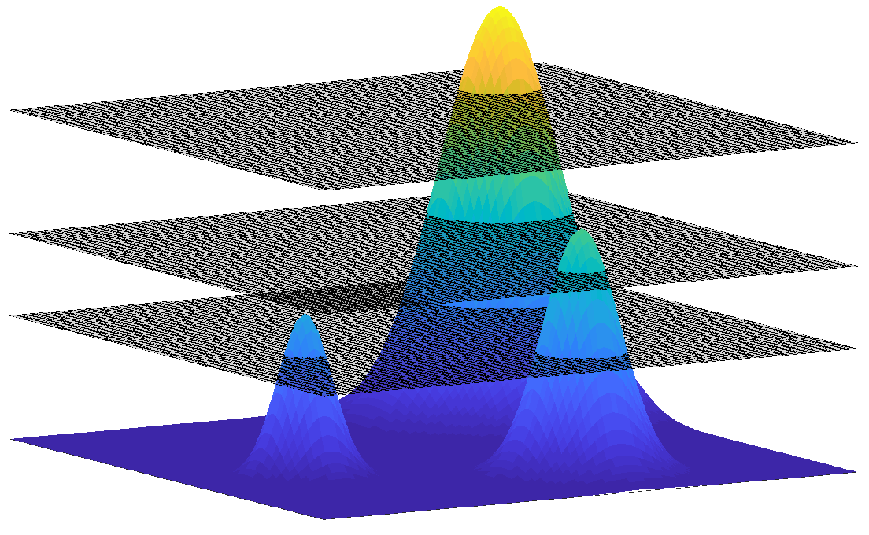
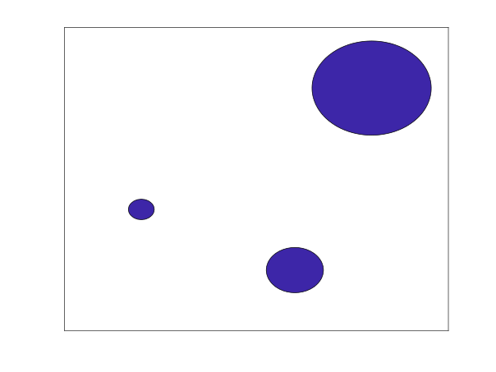
Basic idea
Scalar field associated with occupancy grid maps.
The scalar field is thresholded at various levels.
The superlevel associated with each level.

Slide 4
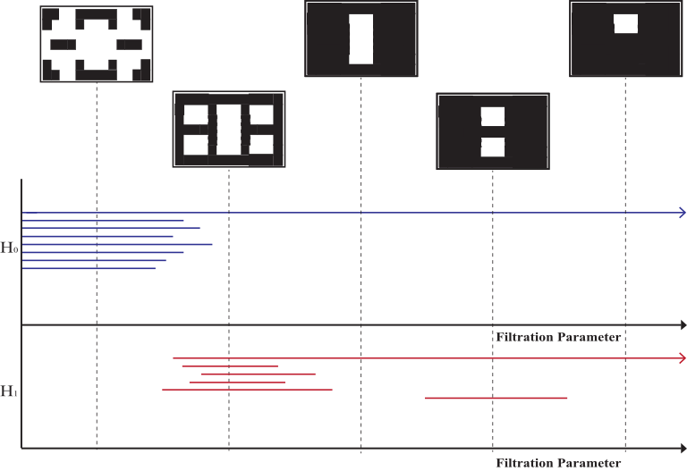
Persistent Homology
Simplicial complex
Cubical complex

Slide 5
Methodology
We identify the persistent topological features in the domain and find the optimal threshold 'a' for which all grid cells with probability more than 'a' belong to an obstacle.
We generate superlevel sets at various levels of the occupancy grid map.
Construct a simplicial or cubical complex at each level.
Zero homology and one homology of the super level sets are computed.
The value above which the topological features are consistent gives the optimal threshold value.

Slide 6
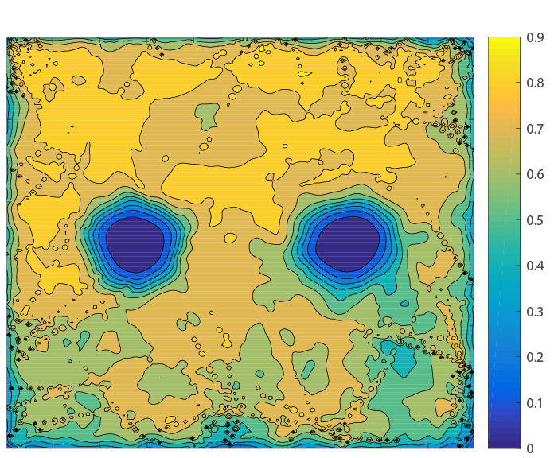
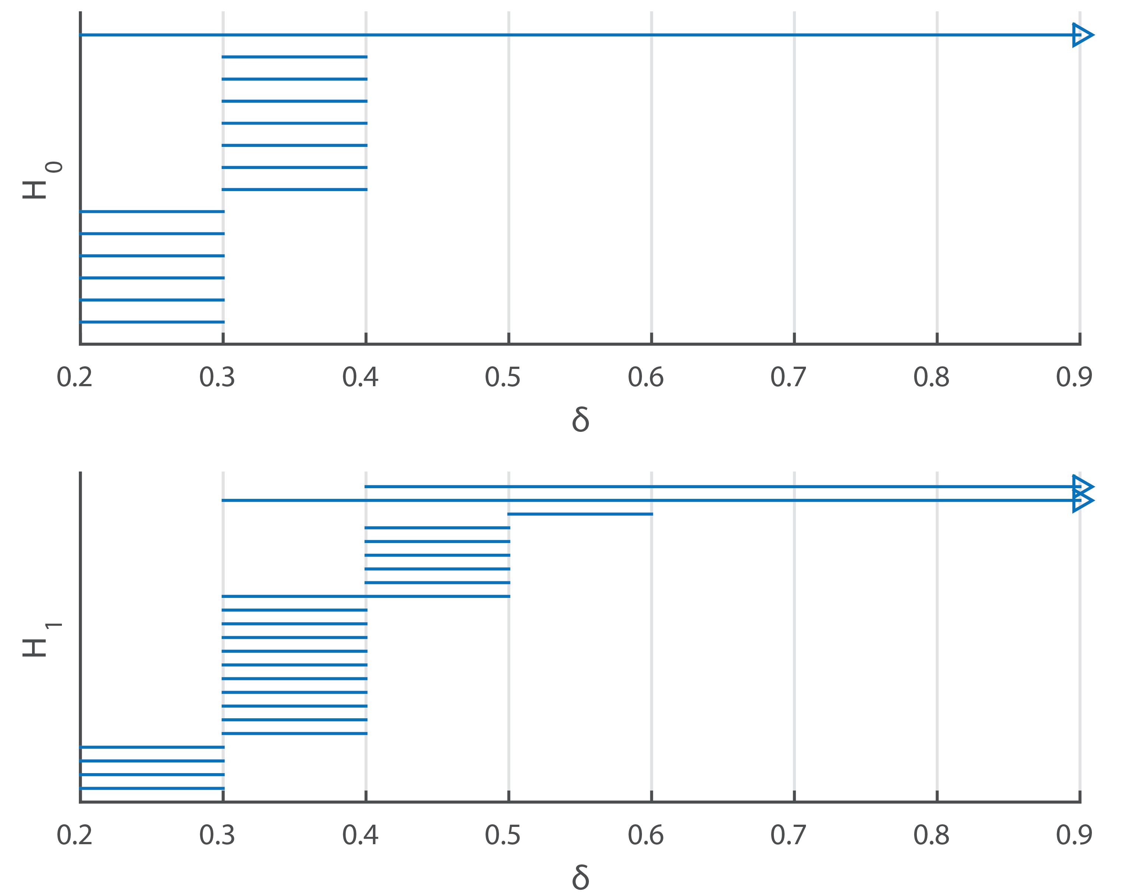
Simulation Example
Optimal threshold
Environment
Unoccupancy map
Barcode
Unoccupancy grid map from simulation data with unbounded localization noise

