Slide 1
Use of Topology in
Optimal Motion Planning
Ramkumar Natarajan
Ph.D. student, Robotics Institute, CMU
Presenting on behalf of Prof. Howie Choset, RI, CMU
Co-advised by Prof. Maxim Likhachev and Prof. Howie Choset
Notes:
Good morning everyone.
As you might know, i am not howie
A first year grad student with howie and max, who just presented
Today i am filling in on behalf of howie as unfortunately he is not able to make it to the talk
Before the talk i wanted to state a disclaimer that unlike other talks presented here which are established or published work from recent years, this is a very raw and ongoing work. So there might be holes or claims which may not be perfect. At the same time, i am fortunate to present this in front of an audience that cares the most and is concerned with topology in planning

Slide 2
Outline
Topology class constraint and invariants
Polynomial Trajectory Optimization
Branch & Bound technique for Polynomial Trajectory Optimization with Topology class constraint
Notes:
Here is the outline of the talk
Ill first begin by describing a particular class of toplogical constraint and invariants from the literature, mainly subhrajit’s work, which are used to evaluate if two trajectories satisfy the topological constraint or not. In other words, these invariants evaluate to same value for all trajectories satisfying the constraint.
Second, very briefly poly trajopt
Demonstrate our approach using that.
In the final part, I will present a branch and bound technique which uses these invariant to satisfy the topological constraint in the context of polynomial trajectory optimization.
So the approach presented here, sort of, blends these two things, polynomial trajectory optimization (which is a subclass of trajopt) and ideas of satisfying topological constraints in path-planning

Slide 3
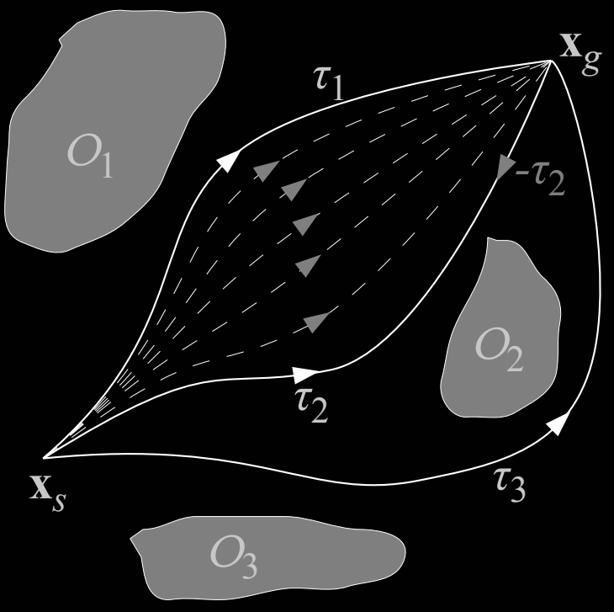
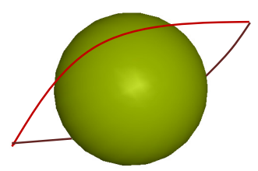
Homotopy Equivalence for Trajectories
Two trajectories are homotopic iff they can be smoothly deformed without intersecting an obstacle
[Bredon, 1993]
In 2D
In 3D and higher
[Bhattacharya et al, 2012]
Notes:
So, first, Ill begin with the type of topological constraint we are focussing on. So in this work, the type of topological constraint we are concerned with is the homotopy constraint.
I don’t think I need to explain homotopy to anyone here, but for the sake of completion, it is something that has to do with two trajectories or continuous functions. Trajectories between same start and goal are called homotopic if one trajectory can be smoothly deformed to look like the other without intersecting the obstacle or taring them apart etc. explain the diagram.
This is the case in 2d. In 3d or higher, it is not pretty straighforward. Explain the diagram.

Slide 4
Homotopy Equivalence for Trajectories
Two trajectories are homotopic iff they can be smoothly deformed without intersecting an obstacle
[Bredon, 1993]
In 2D
In 3D and higher
[Bhattacharya et al, 2012]
Why bother?
An architecture for optimal motion planning
Decide how to grasp an object in a cluttered scene
Stay in line of sight for multi-robot systems
Notes:
So why bother? Homotopy constraint has several applications. In the continuous optimization literature, when you work with obstacles as hard constraints, the final solution is restricted to the same homotopy class from where the opt. is seeded, if the gradient updates are reasonably small and trajectory samples are finely spaced. Studying homotopy constraints can help us explore the homotopy class of interest.
Other examples include, grasping where you want the end-effector to pick an item through one hole as opposed to some other or in multi-robot you need to maintain contact which treats the line of sight as a traj in same homotopy.

Slide 5
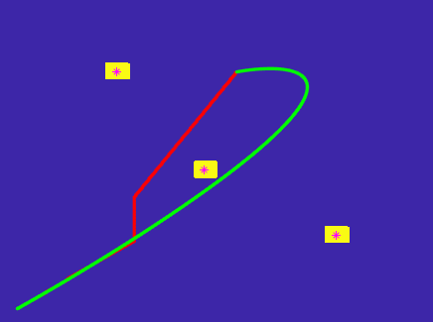
Polynomial Trajectory Optimization
X
Jointly optimizing several polynomials satisfying
Endpoint dynamic constraints
Higher order smoothness and continuity constraints
Satisfying homotopy class constraint is hard
Optimization scales inversely with the number of knot points
X
X
X
Endpoint dynamic constraints must be satisfied
Desired homotopy
Traj. Opt. w/o homotopy constraint
Notes:
Switching gears a little bit, the trajectory optimization method we demonstrate our work on is this subclass called polynomial trajectory optimization.
Here we are jointly optimizing for a sequence of polynomials. So we feed a bunch a waypoints into this optimization and they generate a polynomial sequence such that the overall trajectory satisfies the smoothness, continuity constraint as well dynamic constraints at the intersection of those polynomials.
These methods perform very poorly when there are a large number of waypoints. So if there is a input sample given in the desired homotopy, here in red, too dense waypoints would make the optimization not even converge, on the other hand if the waypoints are sparse, we loose control over desired homotopy.

Slide 6
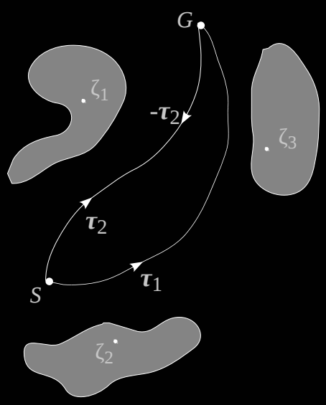
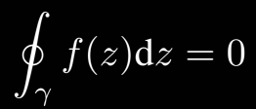
Identifying Homotopy Classes (2D)
[Bhattacharya et al, 2012]
Residue Theorem
Im(z)
Re(z)
The 2D environment is modeled as a complex-valued function f(z)
A pole z_{i} is placed inside every obstacle as a representative point.
The closed loop 𝛄 is formed by 𝜏₁⨆ 𝜏₂
Notes:
So to compare and identify multiple trajectories whether they belong to the same homotopy or not, I would just briefly recall two cool techniques introduced by subhrajit in the literature.
The first one is for 2d. Here we use residue theorem. It states that, if we perform line integral along closed curve on a complex-valued function, then it evaluates to zero, if the func does not have a pole within that closed curve. Or else they evaluate to a unique know value. So the trajectories in comparison form a loop and if no obstacle within, they should evaluate to zero.

Slide 7
Identifying Homotopy Classes (3D)
[Bhattacharya et al, 2012]
Biot-Savart Law
Ampere’s Circuital Law
Obstacles are modeled as current carrying conductors S
Induced magnetic field B(l) is calculated along the trajectory 𝜏₁⨆ 𝜏₂
Trajectories are closed loops within which the current enclosed I_{encl} is calculated
Notes:
I wouldn’t go into so much detail here, but it is straight out of this previous work to distinguist and identify homotopy class in 3d.
We use two famous laws from electromagnetism. One is dual of the other to go from magnetic field at point due to known current flowing through a conductor and current enclosed in a loop due to known magnetic field at any point. Same as before, if we draw analogy, and first model all the obstacle as current carrying conductors, then we can find the mag field along the trajectories in comparison. Using that we can find we can find the current enclosed between those trajectories. The law says the current enclosed is zero is there is no conductor within the loop, in other words, no obstacle within. And evaluates to this value here if there is an obstacle. So gives us a mechanism to differentiate.

Slide 8
Recap until now...
We have a mechanism to compare/identify trajectories in same homotopy/homology class for 2D and 3D
Trajectory optimization that generates sequence of smooth polynomials but no guarantees on homotopy class of solution. In general, optimizing a totally different cost function with no focus on desired homotopy class.

Slide 9
Branch & Bound Homotopy Traj. Opt.
Goal: Find trajectory in desired homotopy with
Minimal number of knot points
Feasible, satisfies dynamics, smoothness and continuity constraints
Solution: Branch & Bound type method that adaptively adds knot points where homotopy constraint is violated
Notes:
a simple recursive algorithm
enforce the traj optimization satisfy the homotopy constraint.
motive is to add as little as many waypoints as possible.
assume that we are given a trajectory,
hand-coded or through some discrete search in the desired homotopy.
starts with just the endpoints of the reference discrete path as waypoint and
adaptively adds waypoint only where the polynomial trajectory has to be refined to push to the desired homotopy.
In this case, it is not in desired homotopy.

Slide 10
Branch & Bound Homotopy Traj. Opt.
Notes:
So if the path with just endpoint as waypoint is not in desired homotopy, we do two things. Keep splitting the path with equal distance waypoints from the discrete path, first two segments then three and so on so forth. At every stage, we do a combinatorial search, where we start from replacing one segment at a time to n-1 segment at a time with the portion from the discrete reference traj and see if the hybrid path is in the desired homotopy. In 2.1, not even hybrid path is in the desired homotopy. So we split into 3 equal parts, replace 1 and 2 at a time and see that we finally have a hybrid path in desired homotopy.

Slide 11
Branch & Bound Homotopy Traj. Opt.
Notes:
We expand that state, at this stage a part of our final solution is already obtained. We are only refining the part that violates the homotopy constraint in the hybrid path.
From here the algorithm, calls itself. It is recursive in nature as this portion of unsatisfied homotopy constraint is similar to the first step, where we began. So we call the same routine from within and form the hybrid path. Now this satisfies the constraint and we expand that.
Finaally we add the one last waypoint here in for this discrete portion violating the constraint and converge to the desired homotopy with 5 waypoints.

Slide 12
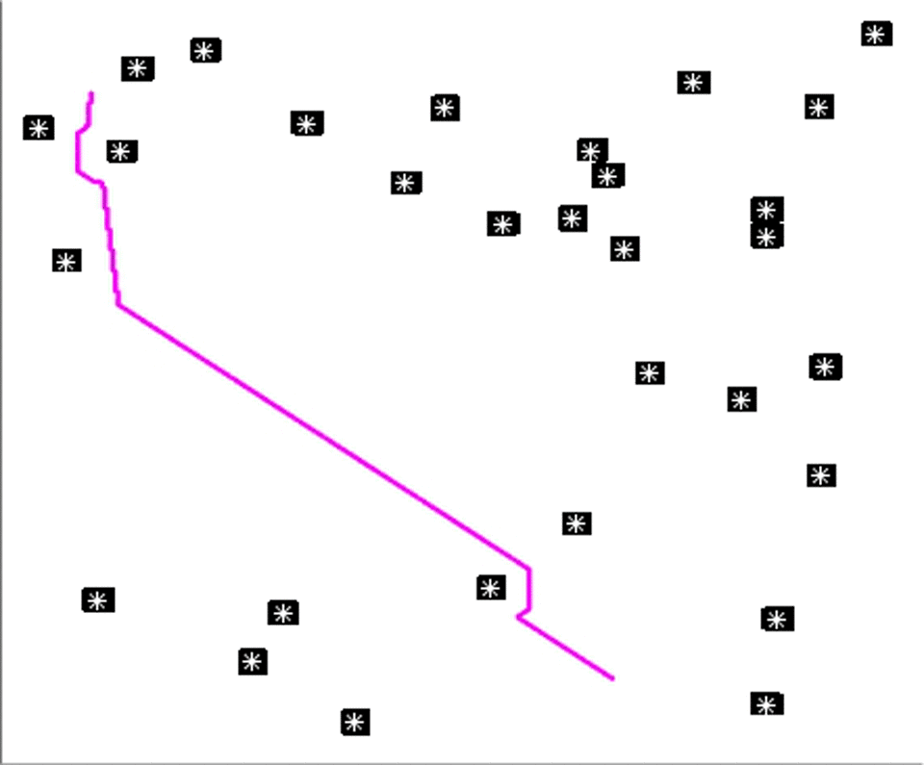
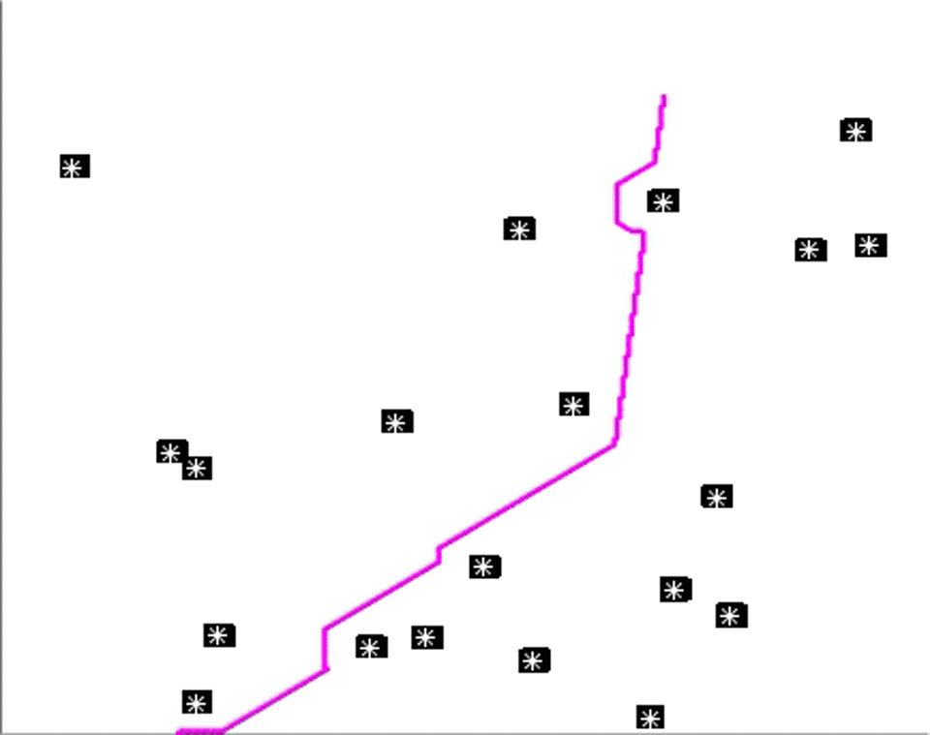
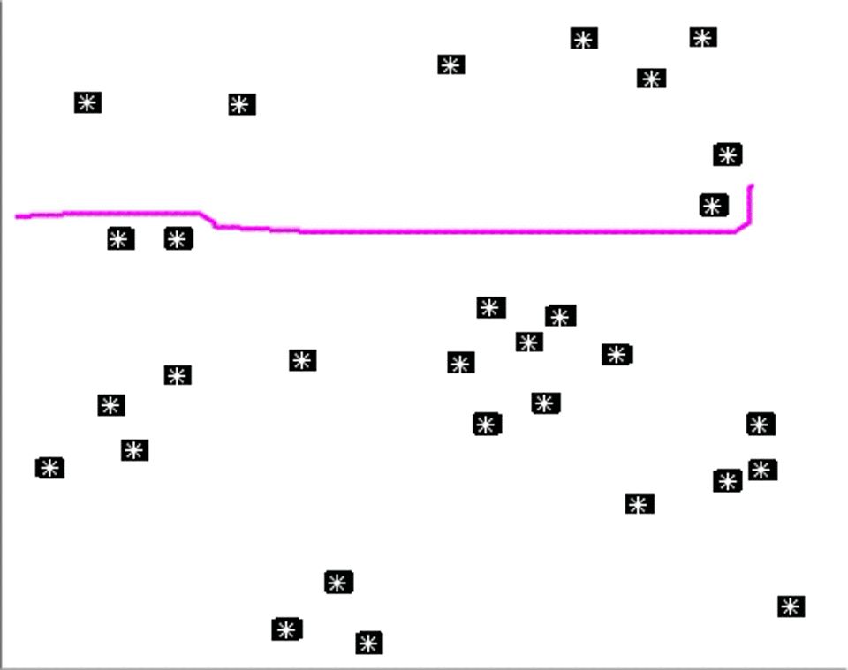
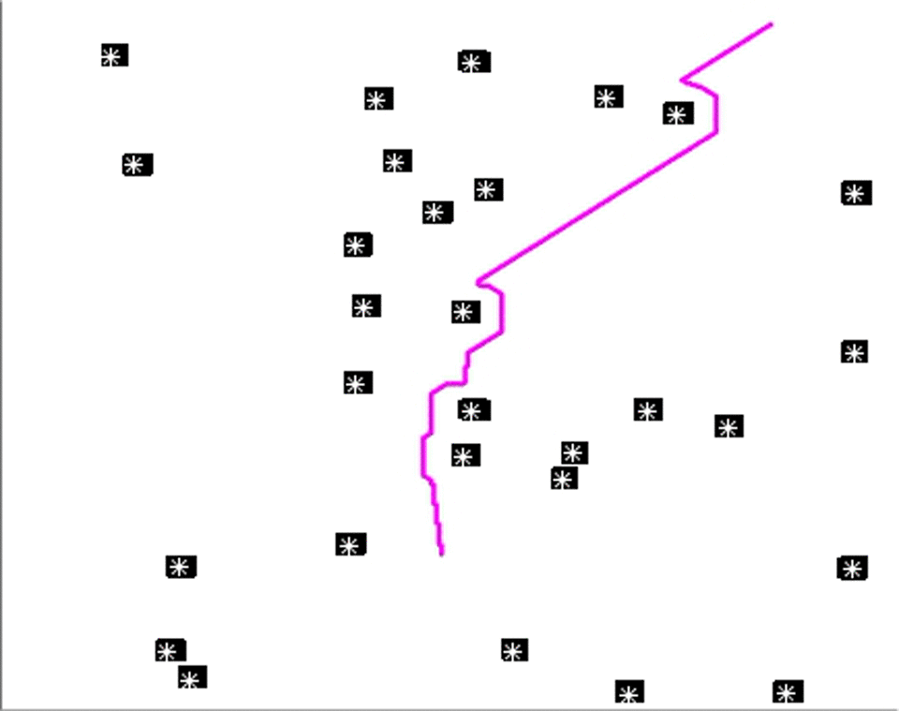
Results

Slide 13
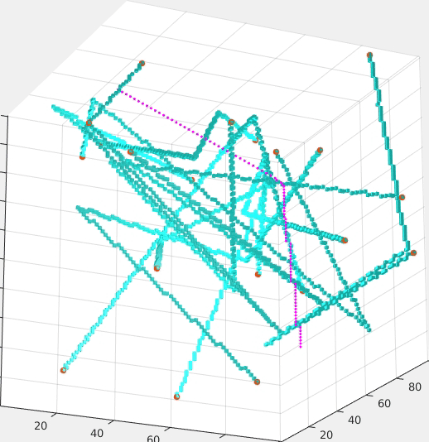
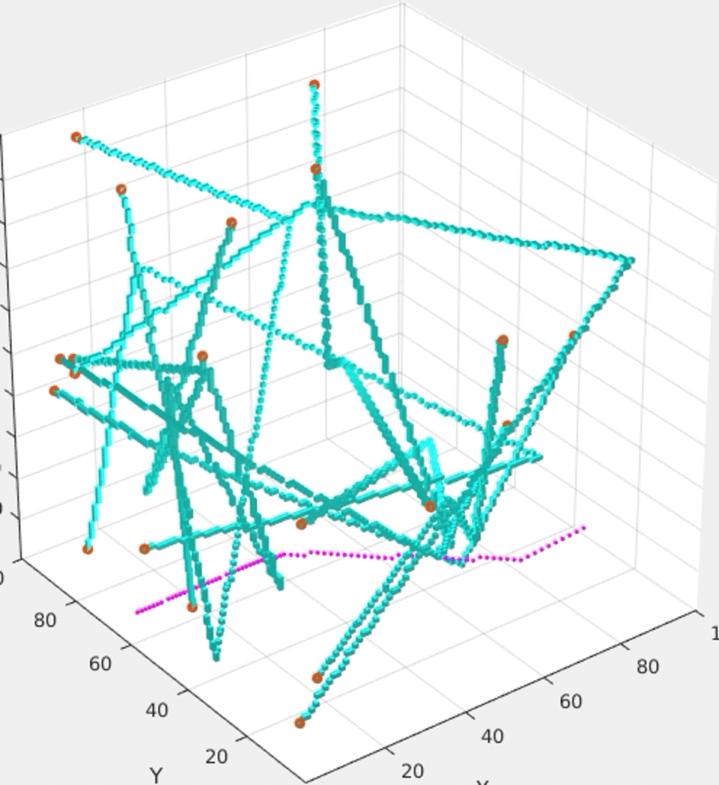
Results

Slide 14
Summary
Trajectory optimization with homotopy class constraints. Algorithm is complete if the reference path is feasible
Satisfy homotopy constraint with few waypoints -> Few calls to the optimizer
Investigate notion of gradient for these homotopy invariants
Notes:
Complete for cases where initial path in desired homotopy is complete

Slide 15
Thanks

Slide 16
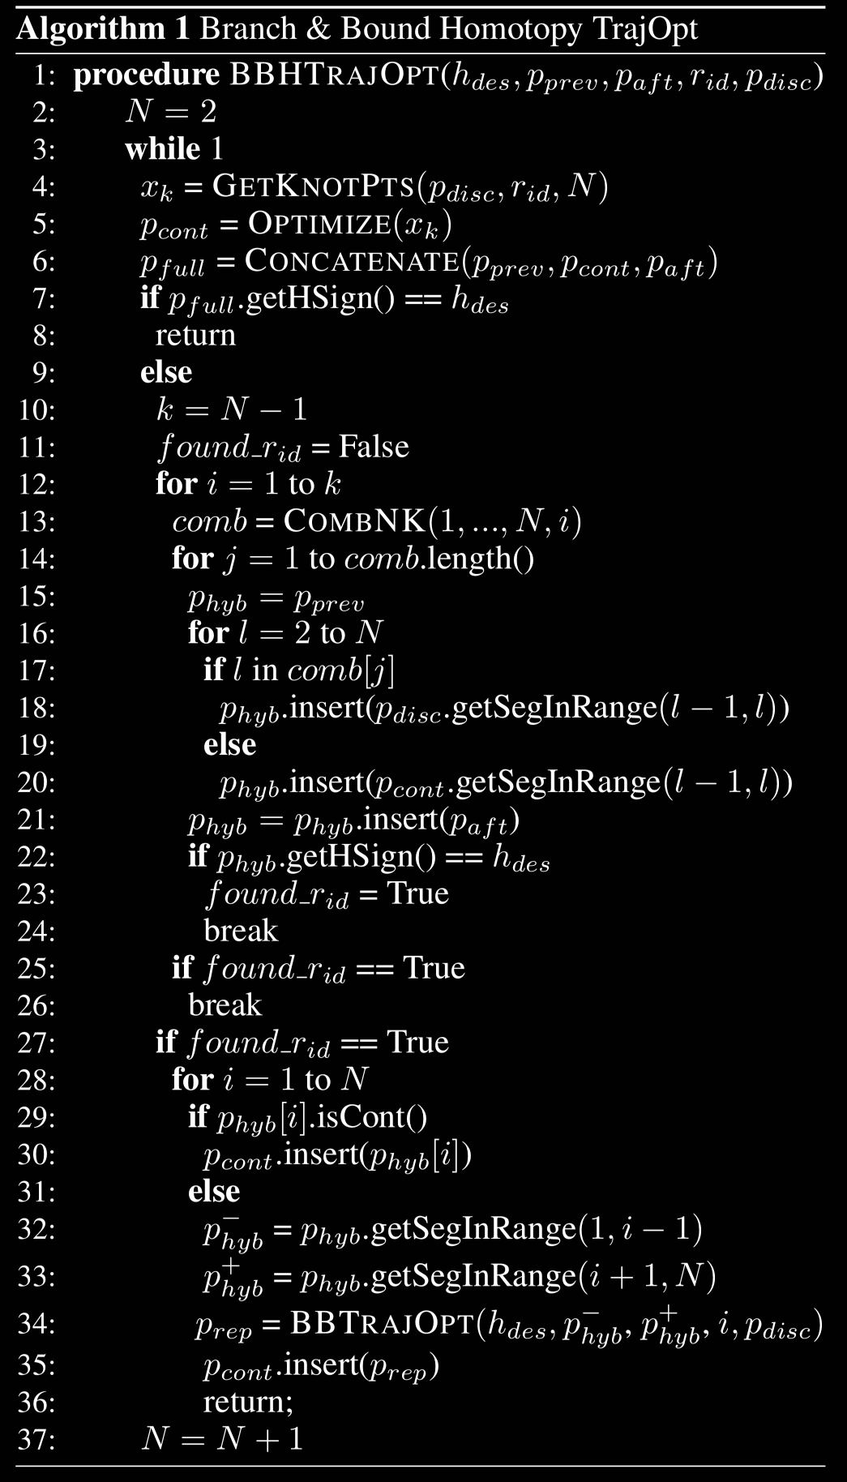
Algorithm

Slide 17
Algorithm

Slide 18
Algorithm

Slide 19
Algorithm

Slide 20
Algorithm

Slide 21
