Slide 1
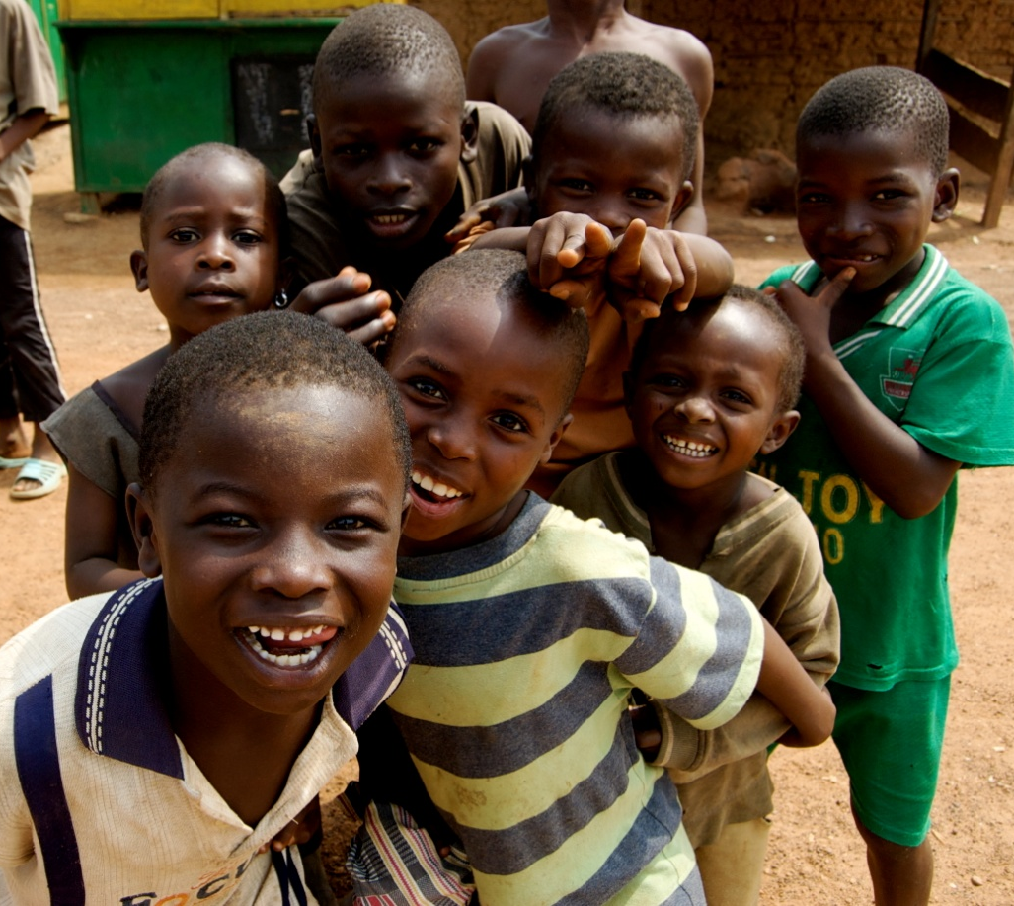


C.A.R.E.
Conservative Agriculture for Rural Empowerment
Glen de Villafranca · Nick Lancaster · Dan Letts
Kate McCarthy · Diego Molina
NIGERIA

Slide 2
Our Definition of Development
Development is the increased freedom and opportunity to improve one’s life and pursue ends according to one’s interests, preferences, and needs.

Slide 3
State of Nigeria
92% live under $2 a day
71% live under $1 a day
Life expectancy is 47 years
  Ranks 216 out of 224 countries in the world
Highest number of malnourished children in the world
Ranks 158th out of 182 countries on the Human Development Index

Slide 4
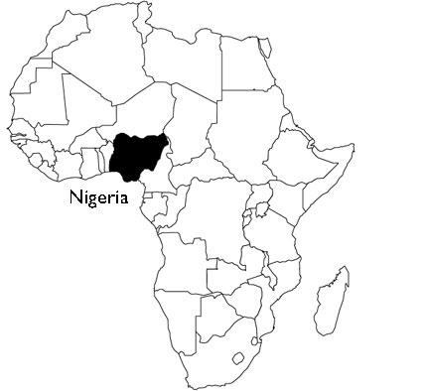
Development Constraints in Nigeria
Patron-Client System
  Inefficient and Unaccountable Government
  Domination of the Oil Industry
    Misallocation of Resources
Poverty
  Large Rural-Urban Divide
  Malnutrition
    Underperforming Agricultural Sector
  Poor Education System
    Low Enrollment Rates

Slide 5
Agriculture in Nigeria
Current Problems
Land Used for Farming in Nigeria
Inefficient Techniques
Deteriorated Soil
Unrealized potential

Slide 6
Education in Nigeria
Low Enrollment Rates
  60% Primary
  35% Secondary
Reasons for Low Enrollment
  Poverty of Parents
  Parents do not see the value of education
  Children need to be at home to contribute to family income
  Few employment options

Slide 7
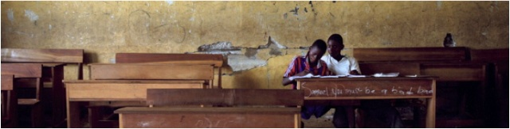
Education and Opportunities
Poverty Impedes Education
  Cyclical pattern
Formal education can lack applicability
  Few opportunities

Slide 8
Mission
We aim to educate rural communities in more efficient and sustainable agricultural practices through the establishment of a demonstrative conservative agriculture farm at a school.

Slide 9
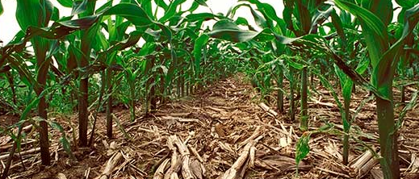
What is Conservative Agriculture?
No Tillage
Cover Crops
Crop Rotation

Slide 10
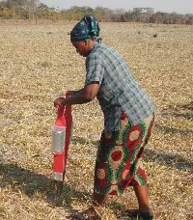
More Efficient Labor
No tillage
Direct seeding
Reduced weeding

Slide 11
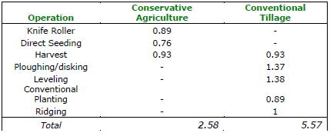
More Efficient Labor
Hours Per Hectare
Food and Agriculture Organization of the United Nations
Much less time is required compared to conventional agriculture

Slide 12
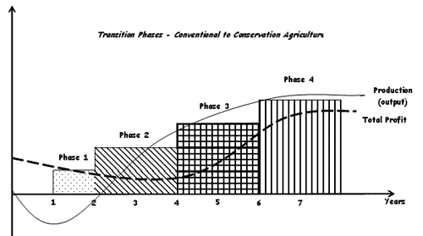
Increased Yields
Over time, yields have been known to increase to twice
and even three times initial production

Slide 13
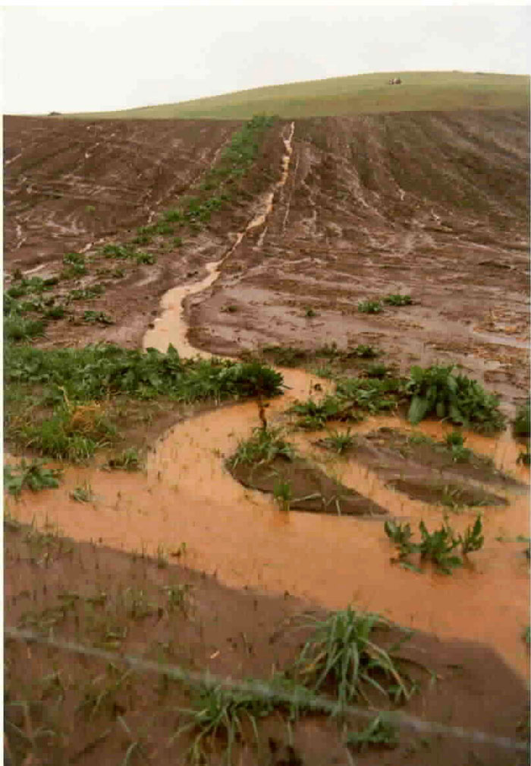
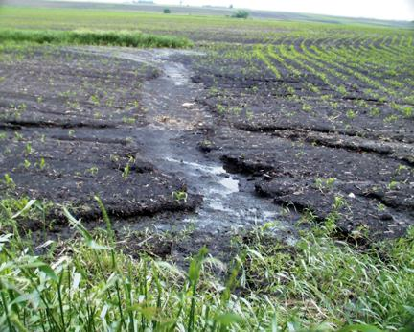
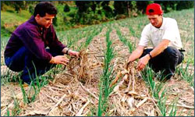
Environmental Benefits
Less soil erosion
Reduced pesticide use
Increased water infiltration to soil
Increased carbon sequestration
Biodiversity
Better soil quality

Slide 14
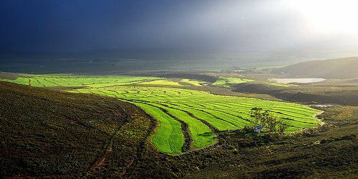
Conservative Agriculture Works
Brazil
Ghana
Egypt
Kenya
Swaziland
Jordan
Venezuela
Cuba

Slide 15
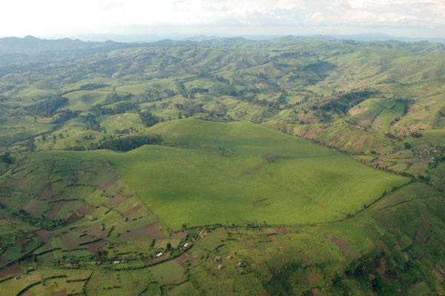
CA Is Well Suited to Nigeria
Climate
Soil Conditions
Inefficient Current Farming Techniques
  Bush Fallow
  Conventional

Slide 16
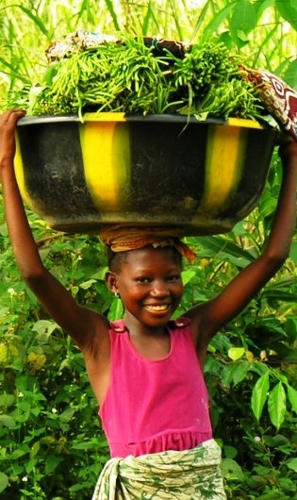
How CA Can Help Nigeria
Go beyond subsistence agriculture
Ameliorate malnutrition epidemic
Allow farmers to expand production
Allow small farmers to escape poverty

Slide 17
Conservative Agriculture for Rural Empowerment
Establish a farm at a rural school
Incorporate CA into curriculum
Educate school and community
Empower rural Nigerians to shape their own futures

Slide 18
What C.A.R.E. will accomplish
Benefits of conservative agriculture
  Economical
  Agronomical
  Environmental
Benefits to students
  Hands on education
  Nutrition
Benefits to community
  No-risk exposure to CA

Slide 19
How It Will Work
Step 1: Preparation
Step 2: Education and Training of Supervisors
Step 3: Preparing the Land
Step 4: Select and Plant a Cover Crop
Step 5: Cultivate Staple Crops

Slide 20
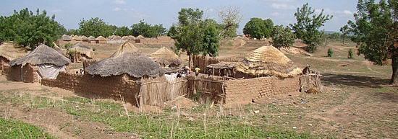
Step 1: Preparations
Choose a location
  Rural
  Suitable Climate and Soil Conditions
  Unproductive agricultural sector
  Potential

Slide 21
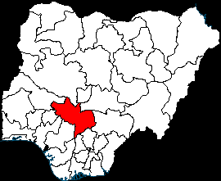
Step 1: Preparations
Kogi State, Nigeria
  One of the poorest in Nigeria
  Absent Sharia law
  Very rural and agrarian
  Suitable soil and climate conditions

Slide 22
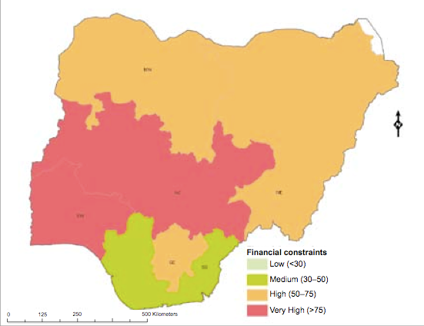
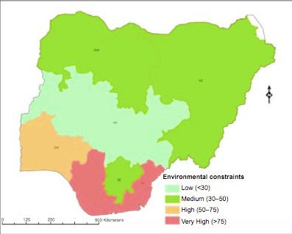
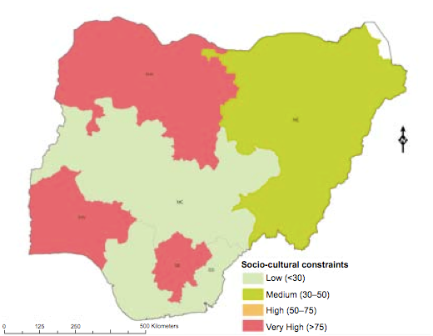
Agricultural Development Constraints:
Kogi State
High Financial Constraints
Low Environmental Constraints
Low Socio-cultural Constraints

Slide 23
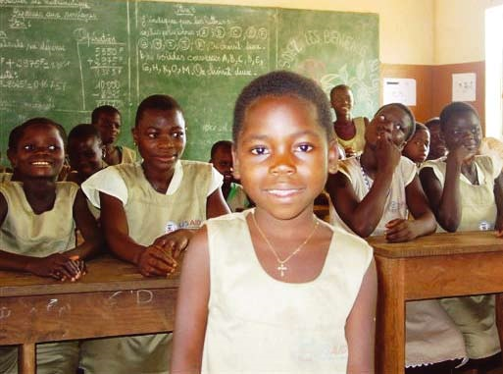
Step 1: Preparations
Select a school
  In selected area
  Number of students on par with national average
  Available farmland
  Willing to adopt CA into curriculum

Slide 24
Step 1: Preparations
Select crops
Crops Chosen
  High yield to labor ratio
  Easily cultivated and harvested
  Nutritious
  Diverse
  Adapted to climate, soil
  Inexpensive
  Cassava
  Egusi
  Cowpea
  Bambara

Slide 25
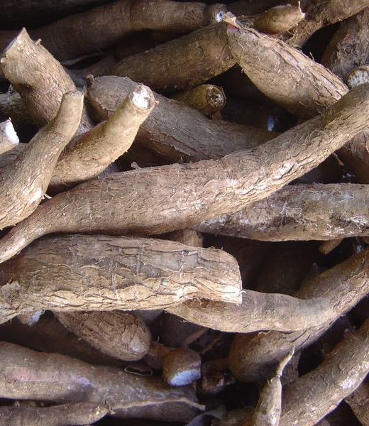
Cassava
Tuber
  grown underground
High yield
Nigeria is world’s largest exporter
Rich in carbohydrates
  Leaves are rich in protein
Easy to prepare

Slide 26
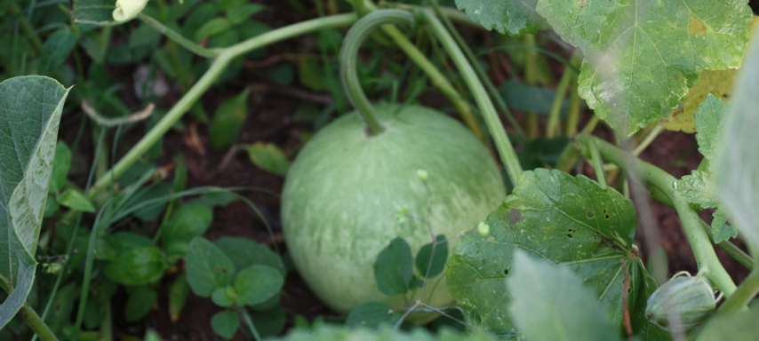
Egusi
Melon, harvested for nutritious seeds
  Essential oils
  Amino acids
  Protein
Incredibly easy to prepare
Stores well
High yield for minimal labor

Slide 27
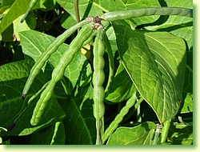
Cowpea
Legume, black-eyed pea
Significant sources of:
  Vitamins A and C
  Calcium
  Iron
  Fiber
  Protein
Fast maturity
Versatile
  Can be eaten at different stages of development

Slide 28
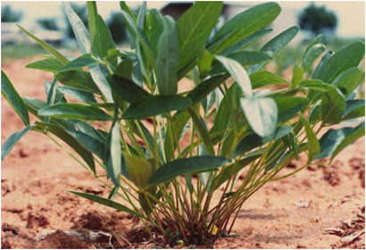
Bambara
Ground nut, similar to a peanut
Nutritious
  Very high in carbohydrates
  Vitamins and minerals: calcium, iron, zinc, vitamin A, methione
  Protein
  High amount of calories per kilogram
Easy to cultivate and harvest

Slide 29
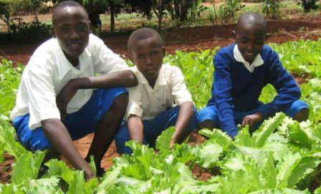
Step 2: Educating and Training
First step in implementation
Teachers, volunteers and local communities

Slide 30
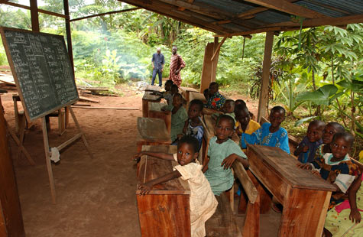
Step 2: Educating and Training
Educating teachers
  Importance of management skills
  Explain conservative agriculture
  Help work into curriculum

Slide 31
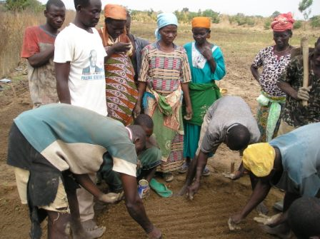
Step 2: Educating and Training
Finding and training volunteers
  Important for assistance on the farm
    Culturally aware
    Year-long stability
  Identify potential volunteers:
    Work with NGOs
    Suggestions from community leaders

Slide 32
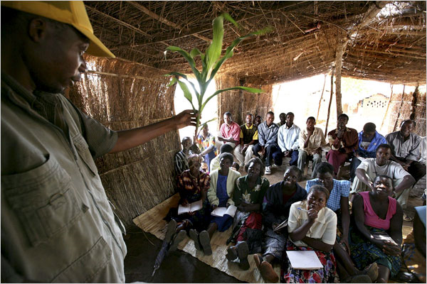
Step 2: Educating and Training
Community workshops and seminars
  Importance of community participation
  Demonstrate advantages of CA

Slide 33
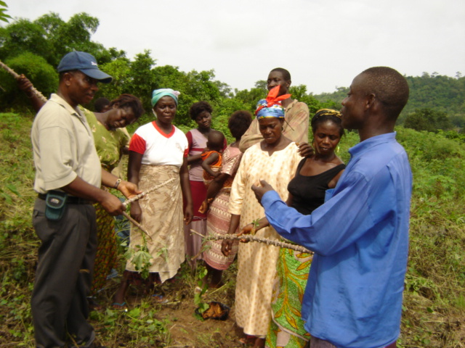
Step 3: Preparing the Land
Prepare farming plot for cultivation

Slide 34
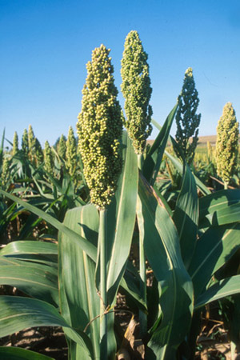
Step 4: Plant Cover Crop
Sorghum
  Grass
  Easily controlled
Plant several times to build up quality of soil
Fits well into crop rotation

Slide 35
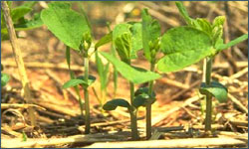
Step 5: Cultivating Staple Crops
Very easy to cultivate, minimal care once planted
Direct seeding and simple harvest
Cassava, Egusi, Cowpea, Bambara

Slide 36
Crop Cycle
Example
Plots for
One Year
Conservative Agriculture Plot
Sorghum
Cowpea
Sorghum
Egusi
Cowpea
Fallow
Conventional Agriculture Plot

Slide 37
Food Production (Estimated)
  We expect to produce a yearly total of:
    10.5kg Cassava
    4.18kg Cowpea
    4.62kg Egusi Seeds
    7.14kg Bambara
    25.44kg of Total Food
  Students will receive an average of .124kg (.273lbs) of food per day as a snack.

Slide 38
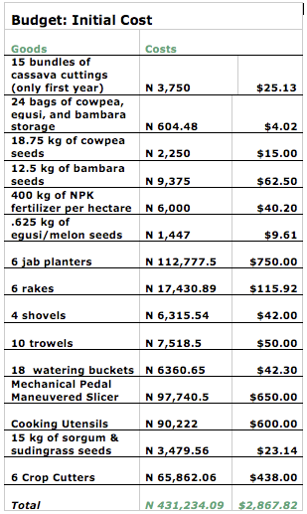
Budget: Start-up Costs
Total Start-up:
$2,868.82

Slide 39
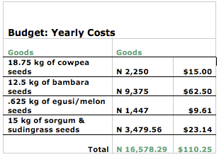
Annual Costs
Annual Budget:
$110.25

Slide 40
Conclusion
Conservative agriculture is effective
It is ideal for Nigeria
C.A.R.E. will a have real impact at a very low cost

Slide 41
QUESTIONS?

