Slide 1
Developing Ghana
Tommy Dewick
Ashley Ozery
Kara Werner

Slide 2
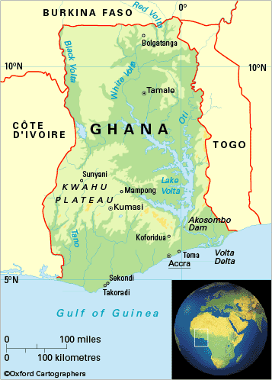
Table of contents
Definition of Development
Economy
Education
The State
Agriculture
Healthcare
Infrastructure
Proposal Ideas
Conclusion

Slide 3
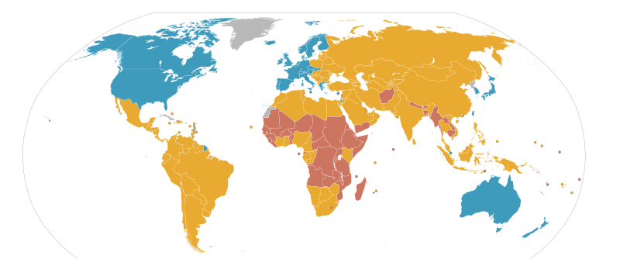
Definition of Development
Economic Growth + Social Change
Notes:
Development is an interrelationship between economic and noneconomic elements of society.
Economic growth is defined as the increase in GDP or other measures of aggregate income.
Economic growth can be driven by improvements in domestic savings, trade balance, and international investment position, to name a few.
Social change, the second component of our definition, refers to the alteration of the social order of a society. This can be completed by changing human development indicators.
This paper has several key variables of human development including education, healthcare, and infrastructure.
Cannot have one without the other
Three levels of development: UN Development Programme’s Country Classification System
low-developed country, is one that cannot fulfill the basic needs of its population, $1.25/day
medium-developed, working to institute a more industrialized economy and to establish an effective government, while constantly improving the quality of life of their population

Slide 4
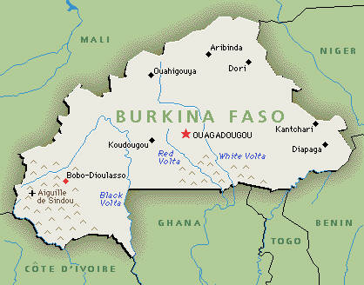
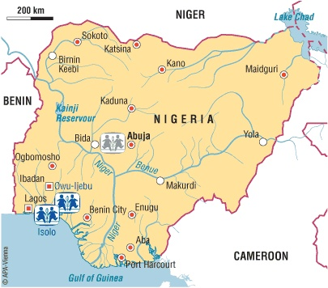
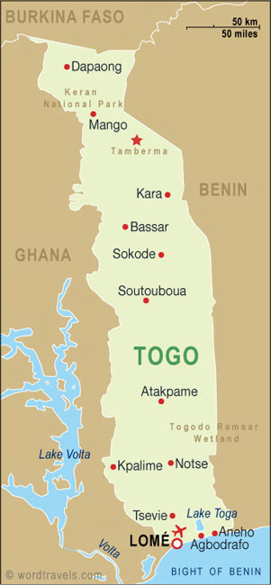
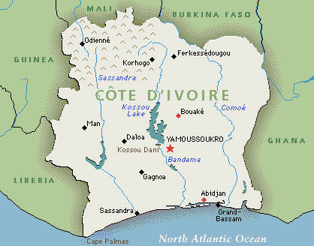
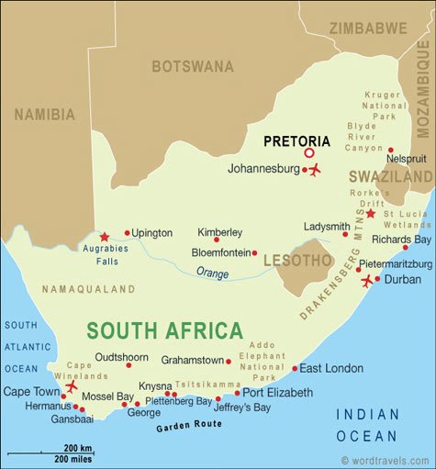
Measuring Development
Notes:
Burkina Faso, Togo (low-developed states), and Côte d’Ivoire (a medium-developed state)
For economics, we chose Nigeria because its GDP per capita is approximately 50% higher than Ghana’s
For human development factors, we chose to use South Africa because it is widely regarded as a successful African state that Ghana could aspire to be.

Slide 5
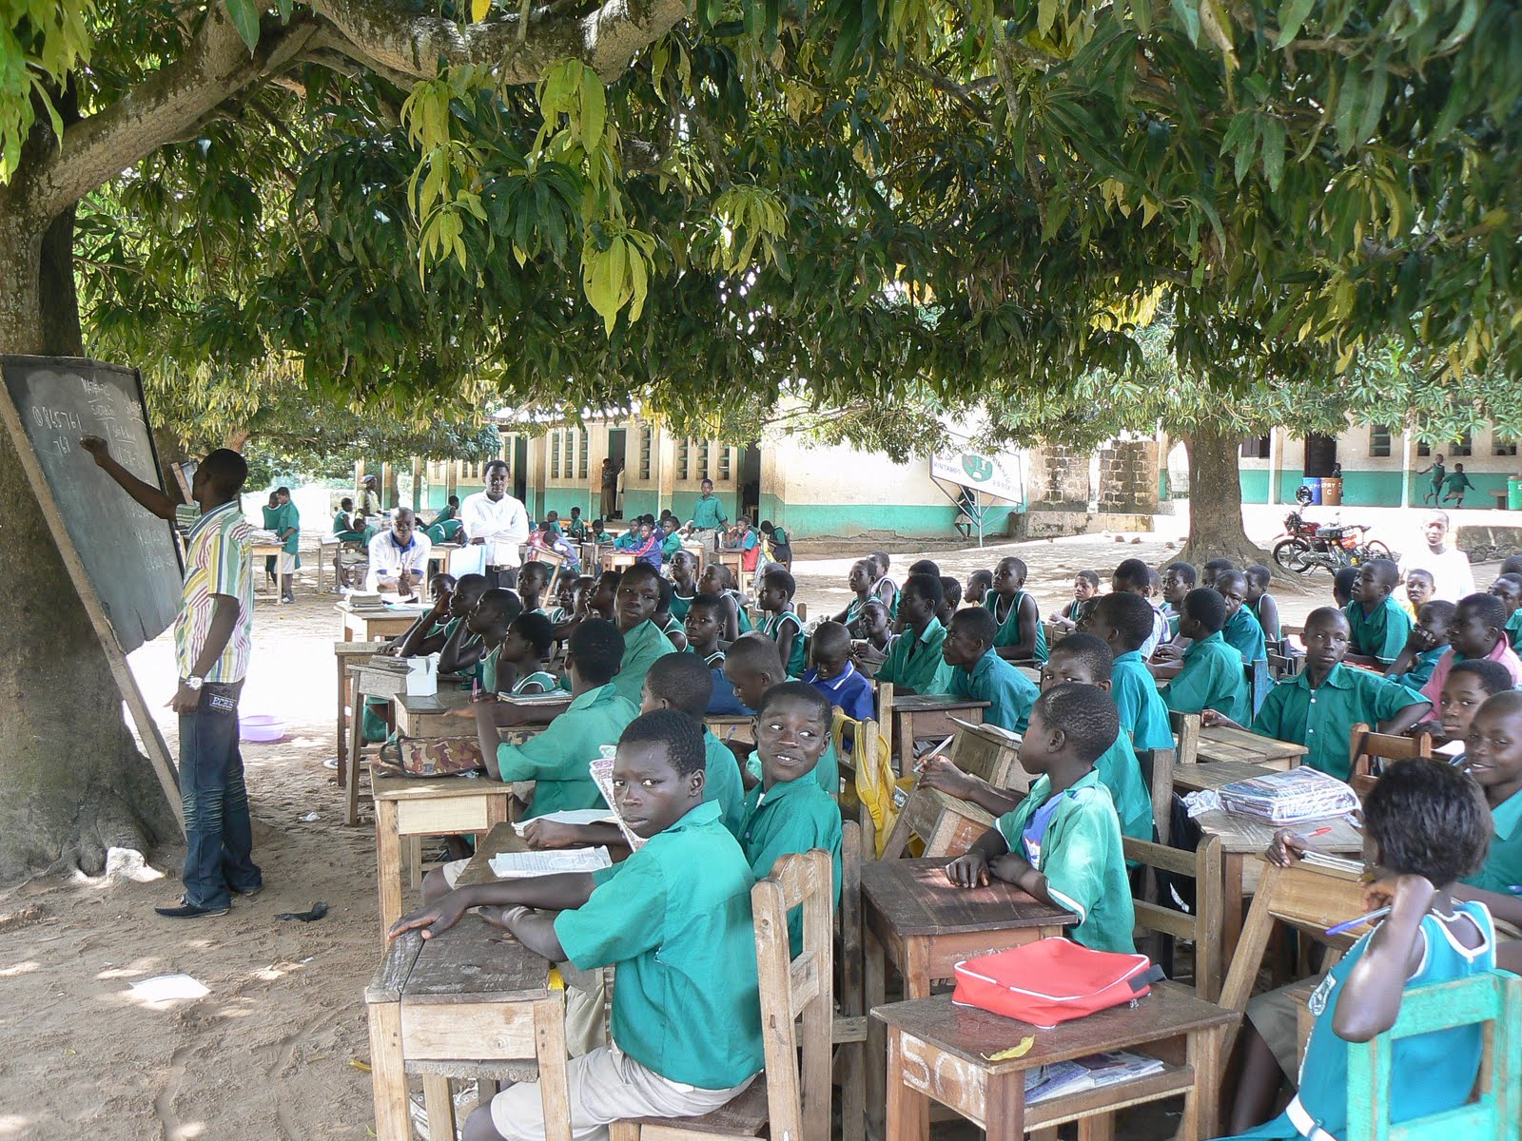
Education
“Higher educational levels are ends in themselves, but education is also a means.”
Notes:
Quote- Dudley Seers
Ghana has made substantial progress in recent years with its education program, but there is still significant room for improvement
history of government financing in education being too low. Government financing fell from 6.4% of GDP in 1976 to 1.4% in 1983

Slide 6
Education (Cont.)
Notes:
This is the percentage of children of official primary school age that are enrolled in primary education as a percentage of the total child population.
The net enrollment ratio of students in primary education improved from 63 percent in 2000 to 77 percent in 2008.
Ghana has also steadily improved its secondary net enrollment rate over the past decade, from 33.8% in 2000 to 47.4% in 2007.

Slide 7
Education (Cont.)
Notes:
Primary completion rates have also increased from 69.5% in 2000 to 75.9% in 2007
Ghana’s literacy rate (as measured by all adults fifteen and up) improved from 58% in 2000 to 66% in 2008.
The official language of instruction throughout Ghana is English.
Students sometimes study in one of the local languages for the first three years, but English becomes the medium of instruction thereafter. Since literacy rates and access to education coincide with one another, it is important for the Ministry of Education to continue to work to improve primary completion rates so students have a chance to start learning English in the classroom.

Slide 8
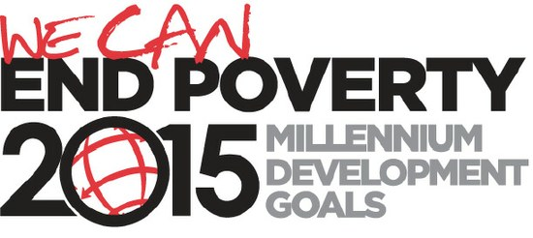
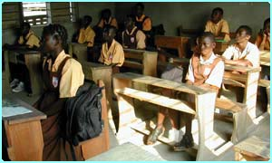
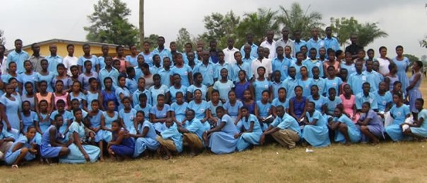
Education (CONT.)
Free and Compulsory Universal Basic Education
Notes:
One of its main priorities at this time is to complete the UN’s Millennium Development Goal of universal primary education by 2015. One of the greatest problems associated with large increases in enrollment rates is that quality of teachers and content tend to decrease at the same time.
The Ghanaian government passed the Free and Compulsory Universal Basic Education (FCUBE) Initiative in 1996. The percentages are still very far below 100% enrollment because of a lack of teachers and other resources. One reason for this is because the education system is highly centralized and the government cannot feed enough money into the system in order to afford everything necessary.

Slide 9
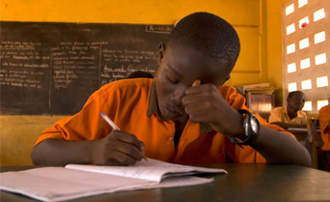
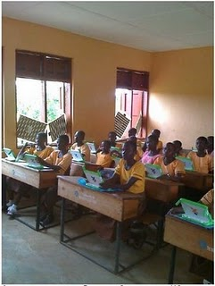
Education Cont.
“Teacher Training Colleges are inefficient in producing effective teachers since the trainees and tutors have so little exposure to actual schools and classrooms”
Notes:
Quote- National Commission on Teacher Education
The Ministry of Education has made it their goal to have teachers at the primary school level at least have a Diploma. This consists of attending a three-year Teacher Training College. The percentage of trained teachers has increased in the kindergarten level in recent years, but decreased in both primary and secondary education (Figure 18). This trend can be partially explained by the increases in the national enrollment rates.
Standards need to be created in order to keep teachers to a high level of excellence and promote a quality education.
-Lack of supervision, don’t show up to classes

Slide 10
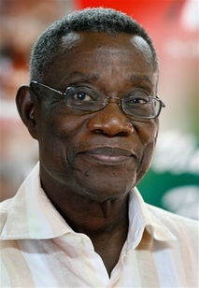
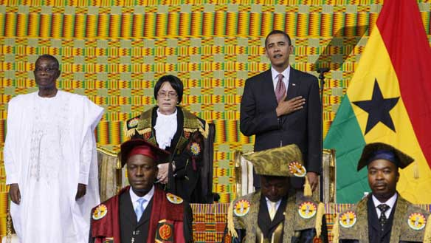
The State
“Economic development requires a government oriented towards development. The government has many roles to play”
Notes:
Jeffrey Sachs- Quote
The state controls almost all sources of development, so looking at corruption, stability, and accountability are all extremely crucial.
The 1993 constitution was developed to prevent coups, dictatorial government, and one-party states. It established a republican democratic government that incorporates ideals from American and British models. The system is one of checks and balances between the President, Parliament, Council of State, and Judiciary.
President John Atta Mills appears to have the support of his citizens in his agenda
The President is the head of the state, government, and armed forces. He is able to appoint the Vice President and Ministers of State. The Parliament is the legislative body of Ghana, with 230 seats, plus the Speaker. Members of Parliament are elected by a civilian vote, every four years. In order for a bill to become a law, it must have the approval of the President. The Judiciary is rule by the Supreme Court, which has the ability to govern on the constitutionality of any legislation or executive action. The hierarchy of the courts was developed similarly to British juridical forms

Slide 11
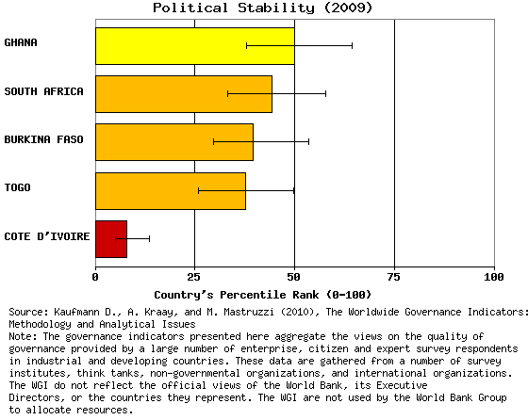
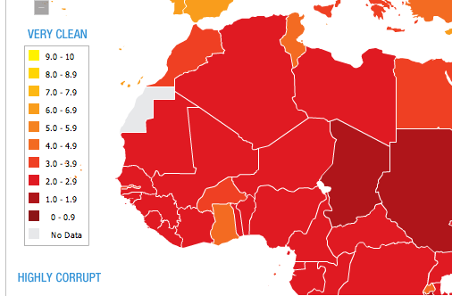
The State (CONT.)
THE SUCCESS STORY OF AFRICA
Voice and Accountability:
60.7%
Rule of Law 51.9%
Notes:
In 2009, President Obama chose to visit Ghana to promote its adherence to democratic principles.
Political stability measures the chance that a government could be undermined or destabilized by unconstitutional actions or violent ways. Events that could trigger political stability to decline include, but are not exclusive to: coups, rebellions, assassinations, riots, non-peaceful demonstrations, and international tensions.
All graphs based on Worldwide Development Indicators show the percentage of countries worldwide that rate below the selected country. Thus, a higher value indicates superior governance ranking. The bars after the lines show the margins of error (90% confidence interval). The different colors show their percentage ranking with the yellow being 50-75% and the orange being 25-50%.
Ghana ranked 62nd with Croatia, Macedonia, and Samoa out of 178 countries.
Transparency International (TI) claims, “Corruption is both a cause of poverty, and a barrier to overcoming it. It is one of the most serious obstacles to reducing poverty.”
According to Freedom House, freedom of expression is constitutionally guaranteed and generally respected. The rights to peaceful assembly and association are also constitutionally guaranteed and permits are not required for meetings or demonstration

Slide 12
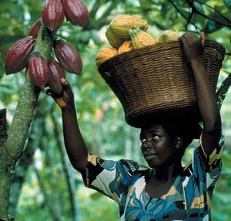
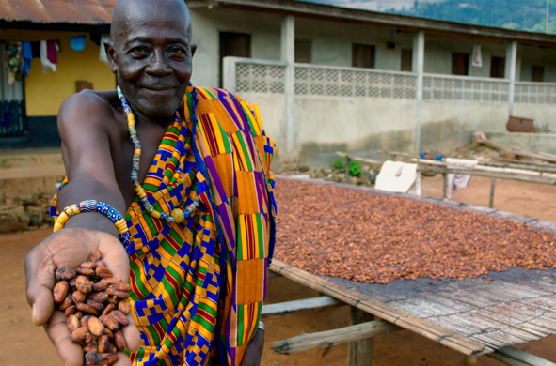
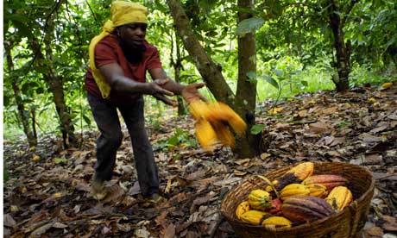
Agriculture
56% of labor force by occupation
40% of GDP
Second largest cocoa producer in the world

Slide 13
Agriculture (Cont’d)
“a malnourished man ’cannot rise significantly above an animal existence’” --- Dudley Seers

Slide 14
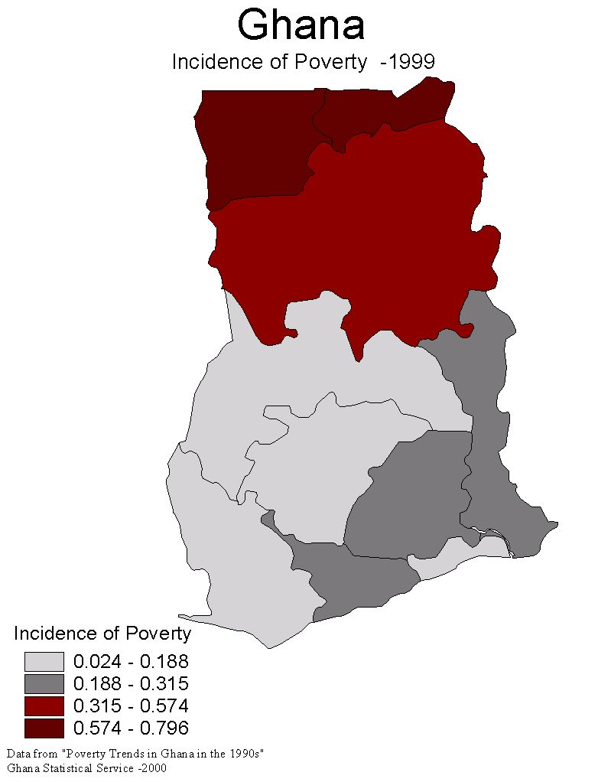
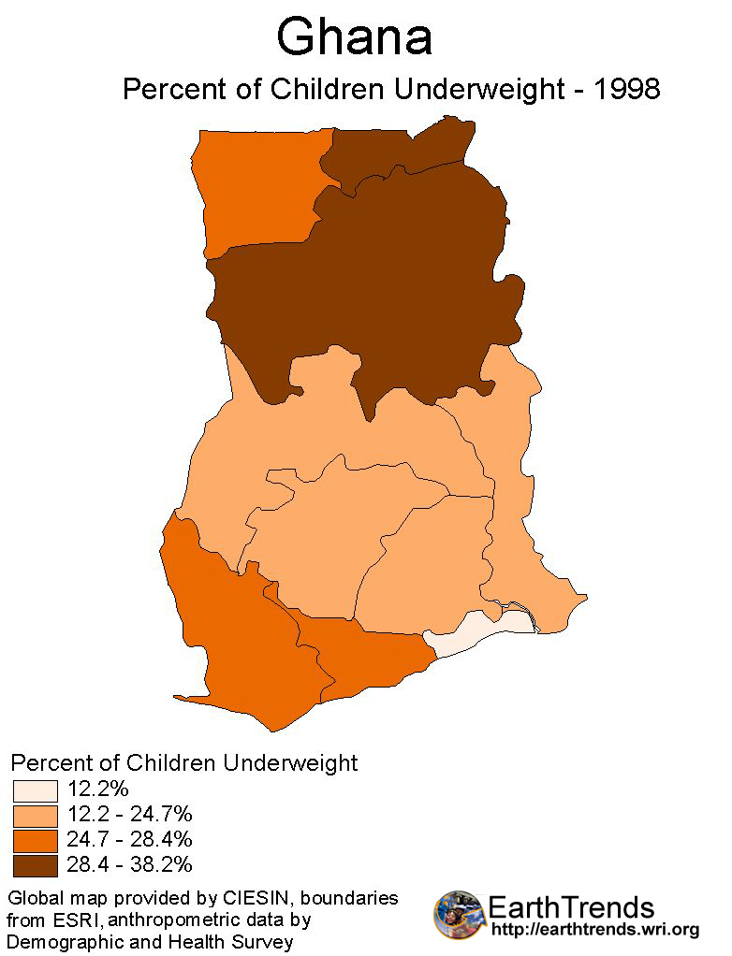
Agriculture - malnourishment
Incidence of Poverty
Percent of Children Underweight

Slide 15
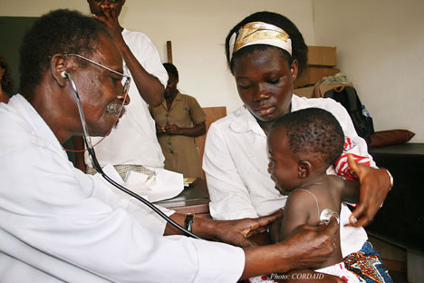
healthcare

Slide 16
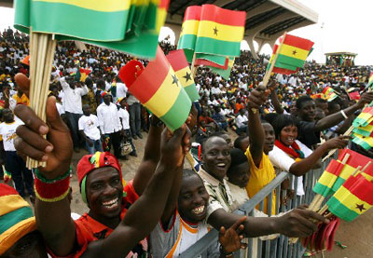
Healthcare – population growth
Ghana’s population growth rate is 2.1% a year

Slide 17
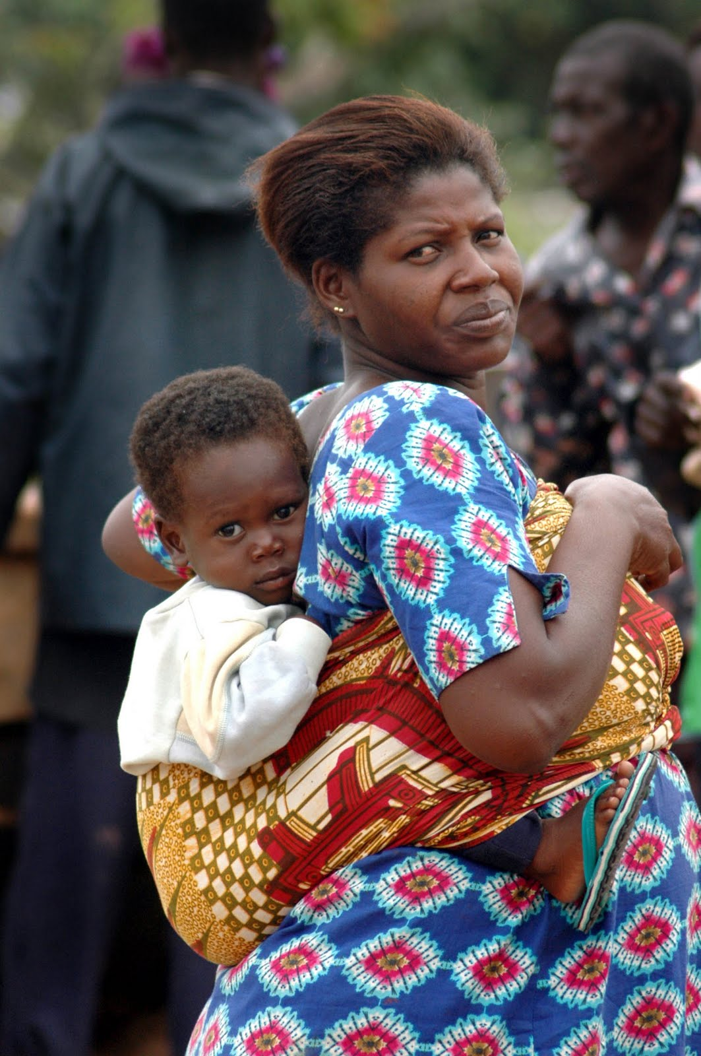
Healthcare – fertility rate
Ghana’s fertility rate is 4.0 children per woman

Slide 18
Healthcare – life expectancy
Life expectancy in Ghana is 56.6 years

Slide 19
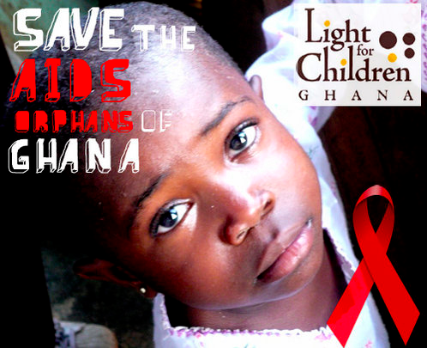
Healthcare – hiv/aids
Leading killer of Ghanaian people
1.9% prevalence rate

Slide 20
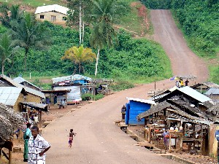
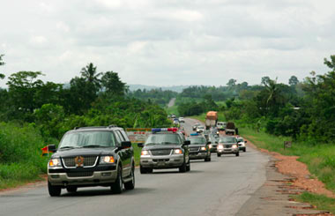
Infrastructure - roads
14.9% of roads in Ghana are paved
Paved roads are mainly found near cities

Slide 21
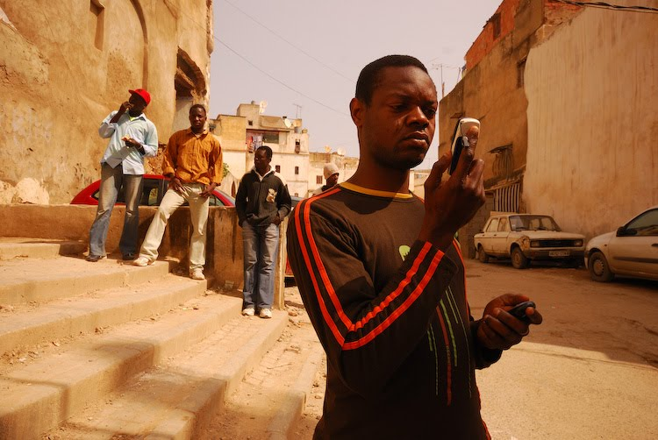
Infrastructure - telecommunications
4.3% of Ghanaians have access to the internet
50% of Ghanaians have mobile subscriptions

Slide 22
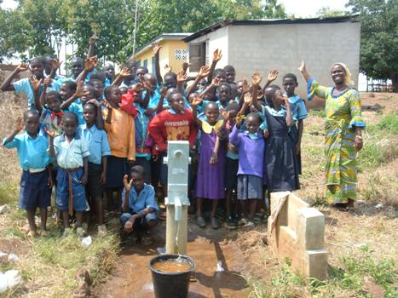
Infrastructure – water access
74% of rural and 90% of urban Ghana has access to clean water

Slide 23
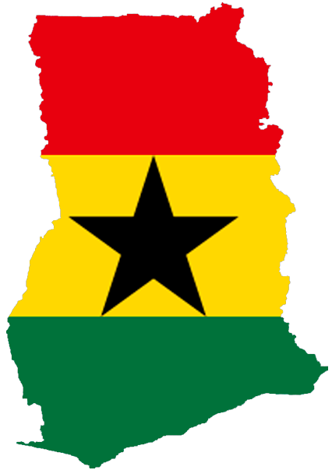
Areas for possible solutions
Quality of educators
Reduce absenteeism
Increase number of teachers
Retraining sessions
HIV/AIDS outreach programming
Improve social stigma
Educate about HIV-prevention
Expand information regarding treatment
Target rural areas

Slide 24
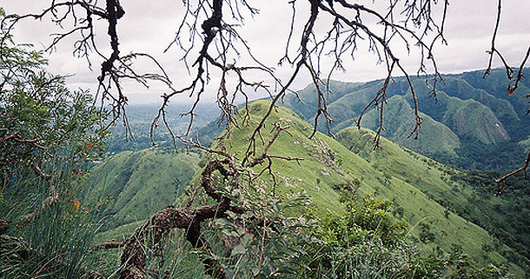
Concluding remarks
Ghana is a medium-developed country
Progress is being made in various sectors
Education and healthcare are two of the most important areas

Slide 25
QUESTIONS?

