Slide 1
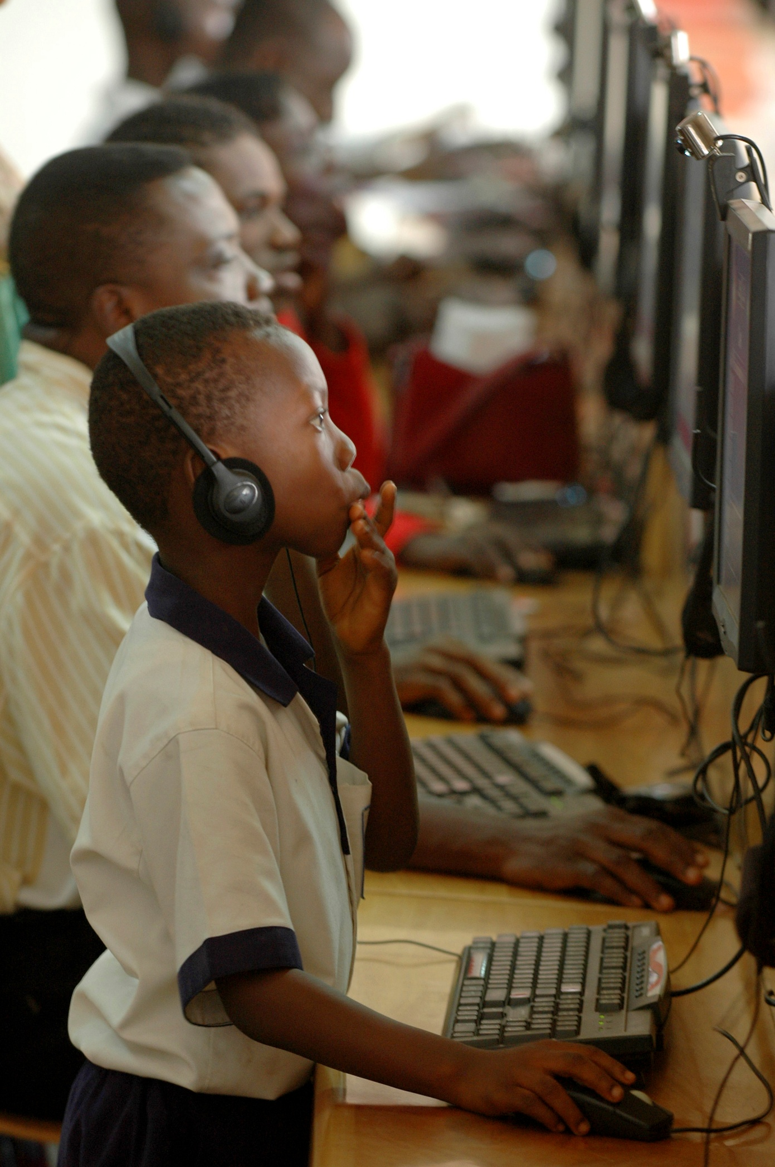
IDEA
Interactive Distance Education Applications
Tommy Dewick
Ashley Ozery
Kara Werner

Slide 2
Definition of Development
Development is a combination of economic growth and social change.
These two measures cannot be truly independent; instead, they are interrelated.

Slide 3
Economy
Ghana’s GDP is $1,552 and is growing at one of the fastest rates in West Africa.

Slide 4
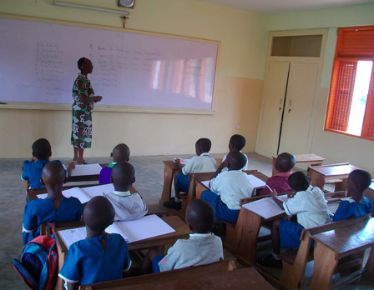
Education
Critical for poverty reduction and development
UN Millennium Development Goal

Slide 5
Primary vs. Secondary School
Enrollment Rates
Completion Rates
2008: Primary school enrollment up to 77%
2007: Secondary school enrollment up to 47.4%
2007: Primary school completion, 75.9%
2003: Secondary school drop-out rate, 13.5%

Slide 6
Quality of education
Teachers
Percentage of
Trained Teachers
Decreased student: teacher ratio
Average class sizes: 35-55
Percent of trained teachers is decreasing each year
Outdated materials in classrooms

Slide 7
Infrastructure
Vital for development of all sectors

Slide 8
Internet Usage

Slide 9
Mission Statement
We aim to help enhance the quality of education provided by a rural Ghanaian school by supplementing its curriculum with distance-learning technology.

Slide 10
Benefits
Compensates for:
Subpar quality of education at Ghanaian schools
Poorly trained teachers
Lessons missed due to teacher absences

Slide 11
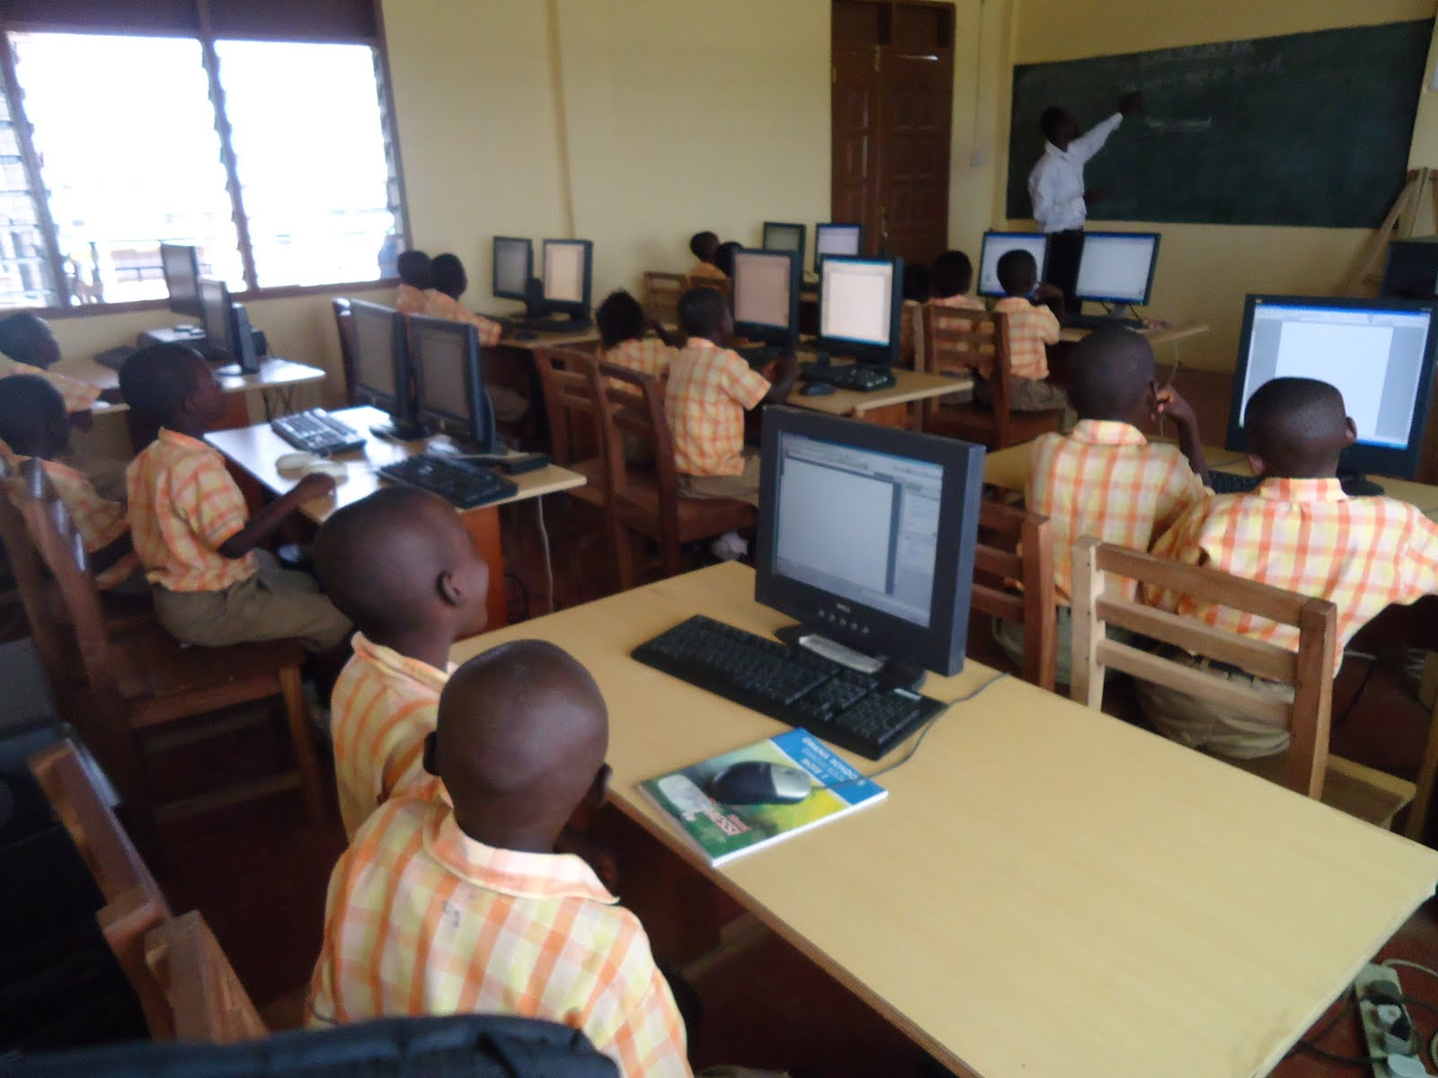
Information & Communications Technology
Provide better economic opportunities
New market access
Skills necessary for professionals
Supplement education
Entertainment

Slide 12
Our Partners
Inveneo
OOG voor Ghana
oneVillage Foundation

Slide 13
Inveneo
ICT company with focus on developing states
Experience in Ghana
Familiar with unique challenges

Slide 14
OOG voor Ghana
Dutch NGO with mission to educate Ghanaians
ICT lesson plans
CDs with educational materials
Computer Science
Teacher Training
Mathematics
English
Typing Programs
Computer Games

Slide 15
oneVillage Foundation
Ghana-based arm of operation
Devoted to increasing ICTs
Sustainability and Workshops

Slide 16
How It Will Work
Step One: Preparation
Step Two: Prepare the Computers
Step Three: Education and Training
Step Four: Implementation into the Curriculum

Slide 17
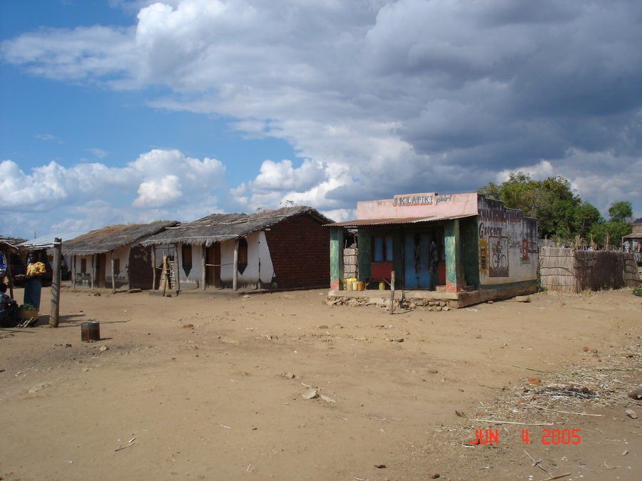
Step 1: Preparation
Choosing a location:
Rural
Access to electricity
Minimal logistical issues

Slide 18
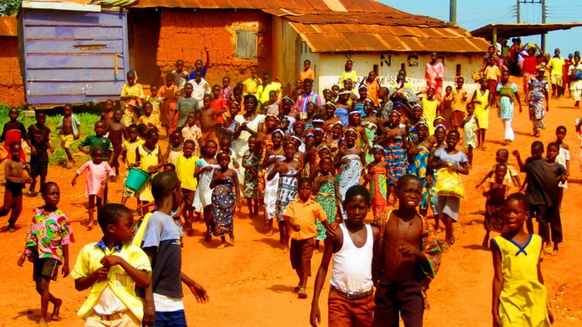
Step 1: Preparation
Afranse, Ajumako district
No government program
Electrical grid
Cooperate with SEAD Ghana

Slide 19
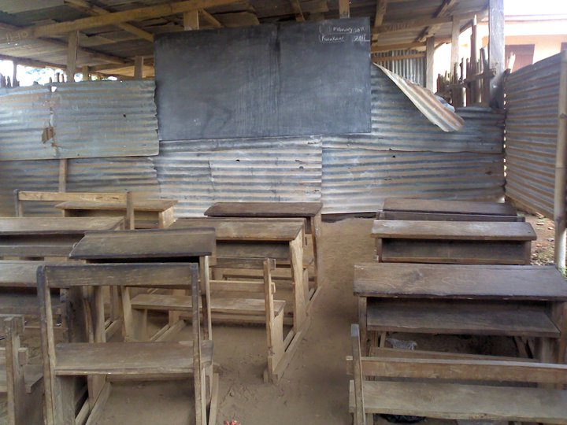
Step 1: Preparation
Choosing a School:
Open to new techniques
Smaller school
Promotes higher education
Not a part of gov. program

Slide 20
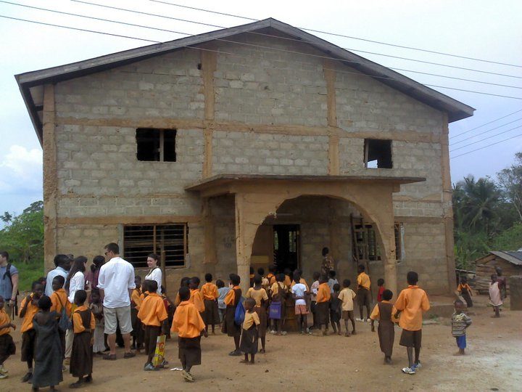
Step 1: Preparation
Kofi Annan Trade School
Only established in 2005
175 students (50 to a room)
Focus on skilled professions
No ICTs in use

Slide 21
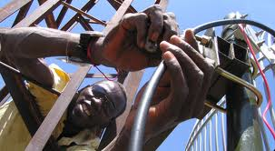
Step Two: Prepare the Computers
3 Computers (50 students/computer)
Choose a quiet room to set up
Provide security

Slide 22
Step Two: Prepare the Computers
Things that need to be provided for:
Inveneo computer technologies
Tables and chairs
Virus protection software
Surge protection
Use Inveneo as a resource

Slide 23
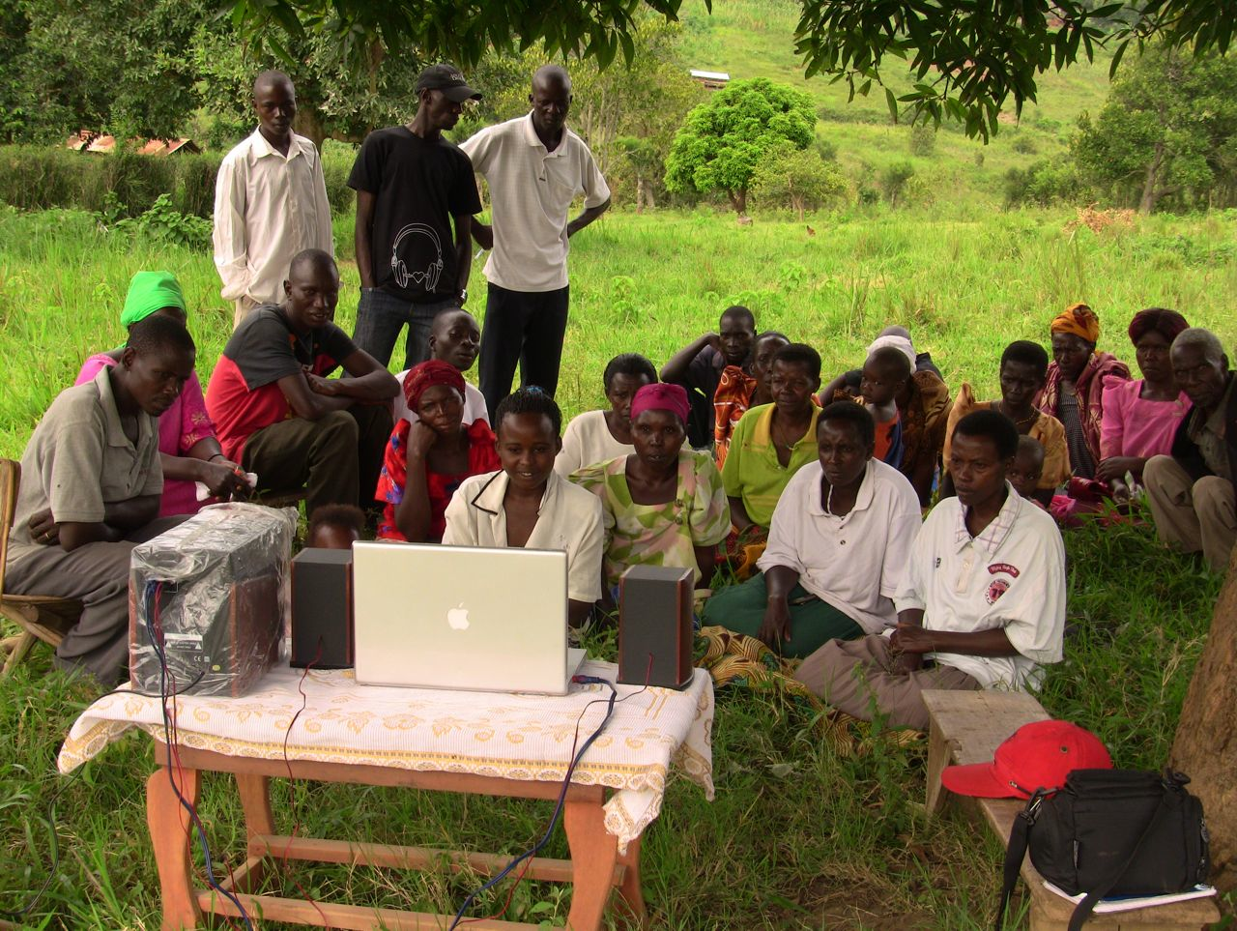
Step Three: Education and Training
Educate teachers, students, and volunteers in the community

Slide 24
Step Three: Education and Training
Educating ourselves for implementation:
Week One: applied theory, technology
Week Two: solution deployment
Establish modes of communication for future

Slide 25
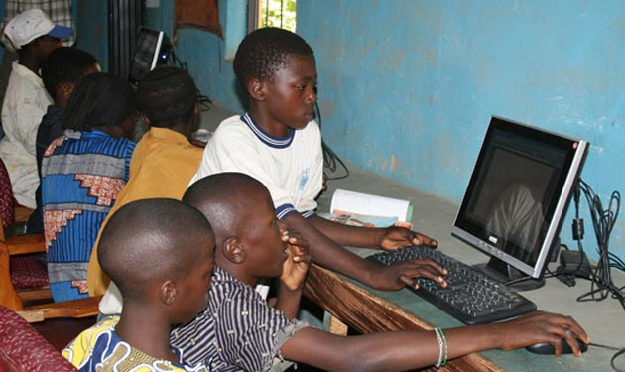
Step Three: Education and Training
Involve the rest of the community:
Community workshops/seminars
Explain technology as a teaching method
Night classes provided by the school

Slide 26
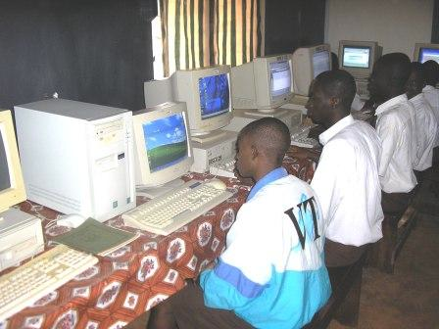
Step Four: Implementation into the Curriculum
Teachers need to understand OOG educational content
Coordinate lesson plans with Basic Education Certificate Examination
Yearly reevaluations of curriculum

Slide 27
Budget
GOODS | COSTS
3 Computers | $1800
Furniture (3 Tables, 7 Chairs) | $300
Technical Support | $750
Power Equipment | $850
Transportation to Ghana for One | $1400
Project cost over 5 years: $5100

Slide 28
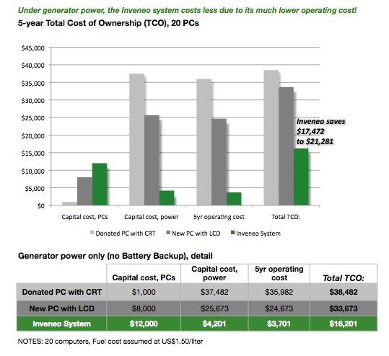
Budget

Slide 29
Conclusion
ICTs create new opportunities and supplement existing education
Both short-term and long-term benefits for Ghana
IDEA will a have real impact at a very low cost

