Slide 1
Nuestra Comunidad
Emily Gordon
Hallie Hughes
Marcela Zablah
“Haciendo El Salvador Más Seguro”
“Making El Salvador Safer”
Notes:
Emily

Slide 2
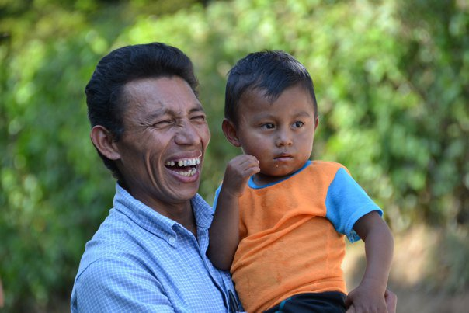
What is Development?
“Development should be synonymous with quality of life”
“A good quality of life means not only having your basic needs met, but living life free from disease, hunger, and corruption”
Notes:
Hallie

Slide 3
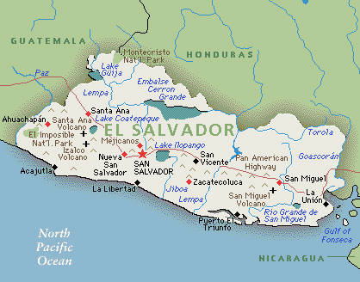
Basic Information About El Salvador
Population: 6,071,774
Total Area: 21,041 Sq Km
Location: Bordered by the Pacific Ocean, Guatemala and Honduras
Notes:
Marcela

Slide 4
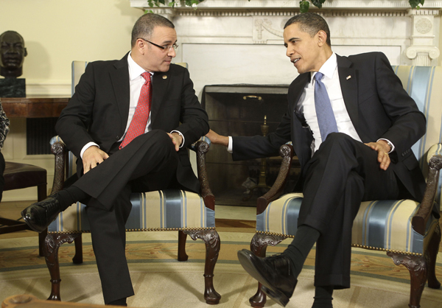
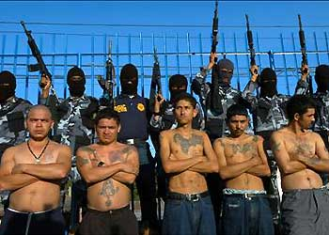
Biggest Issues
Economy
Crime Rates
Notes:
Emily

Slide 5
Economy
Notes:
Hallie

Slide 6
Crime
There are 14 murders per day on average in El Salvador.
Notes:
Marcela

Slide 7
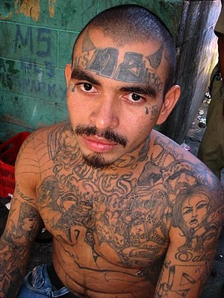
How Crime affects Development
Waste of human & social capital
Economic effects
Government distrust
Notes:
Emily

Slide 8
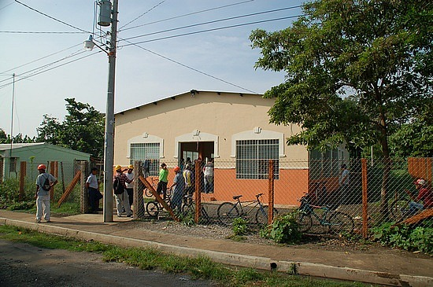
“Nuestra Comunidad”
We would like to build a community center that will offer programs for both youth and adults
Community-based effort to combat violence and provide an alternative to gang life
Notes:
Hallie

Slide 9
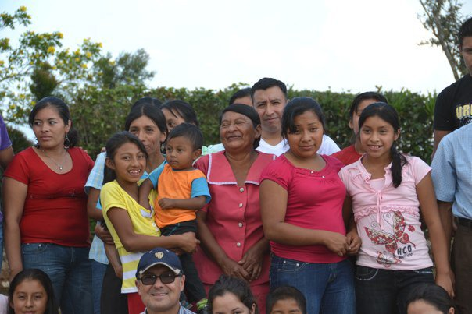
Our Mission
To promote social cohesion
Reduce the risk factors of juvenile violence
Offer a safe space where youth and adults can feel at home
Increase opportunities
Notes:
Marcela

Slide 10
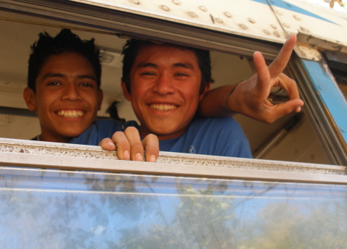
Potential Partners
Global Financial Education Program
Magicians Without Borders
Soccer Without Borders
Un Techo Para Mi Pais
Simply Help
USAID
Notes:
Emily

Slide 11
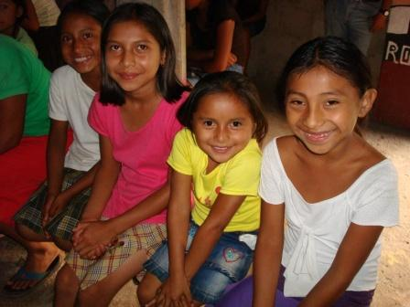
Programming- Youth
Educational and fun after-school activities
Vocational Training
Rewards Program – Incentive to save
A safe place to be, and an outlet from gang violence
Notes:
Hallie

Slide 12
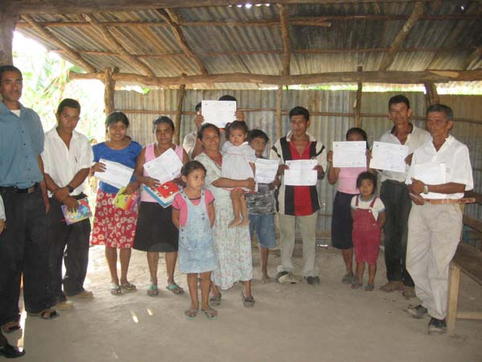
Programming- Adults
Vocational Training
English Language, Computer Skills, etc.
Financial Education
Notes:
Marcela

Slide 13
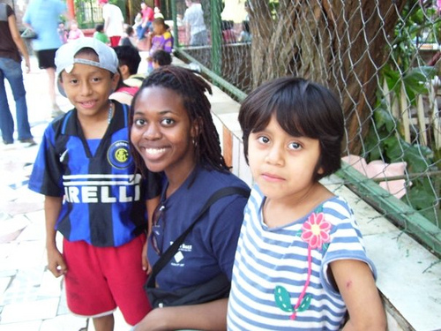
Volunteers/Staffing
Permanent Director
Highschool and University Volunteers
Internship Opportunities
Local Staff Members
Notes:
Emily

Slide 14
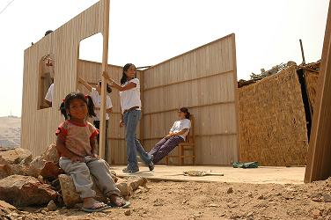
Location
On the ground research
Partnership with Un Techo Para Mi Pais in choosing a location
Notes:
Hallie

Slide 15
Budget
Tentative Budget:
Construction of Building: $1,500
Salaries: Security Guards (2): $750/month
Educational/Financial Curriculum: $100
Sports Equipment: $0
Computers: $0
Maintenance Fund: $0
Total Start-Up: $10,600.00
Total Annual Costs: $9,000.00
Notes:
Marcela

Slide 16
Timeline for Future
1) Summer 2011- Research & Location Picking
3) Spring 2012- Opening of the Center, Start of Programming
2) Fall 2011- Construction of Community Center
4) Summer 2012-onwards- Community Center will be running, we will be improving and adding programming
Notes:
Emily

Slide 17
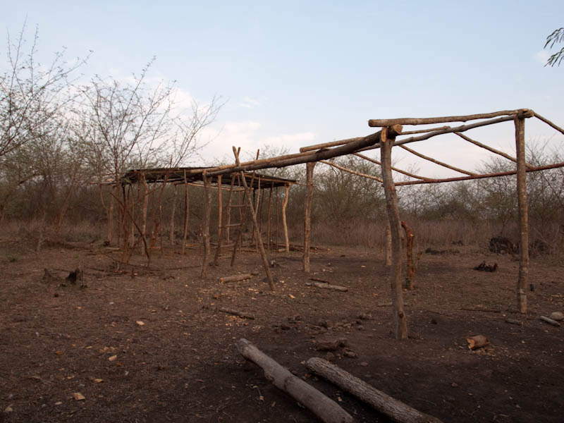
Phase 1- Research
Finding Location
Partnering Local University
Recruit Volunteers
Notes:
Hallie

Slide 18
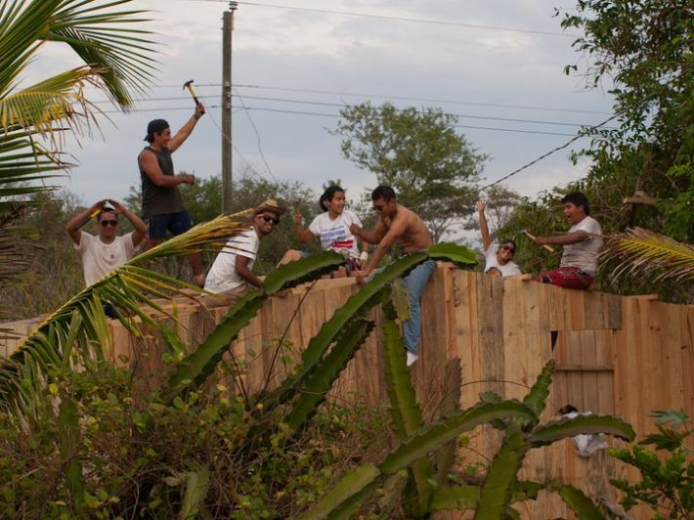
Phase 2- Preparation
Construction of building
Find teachers
Build trust and relationship with the community
Prepare programs
Notes:
Marcela

Slide 19
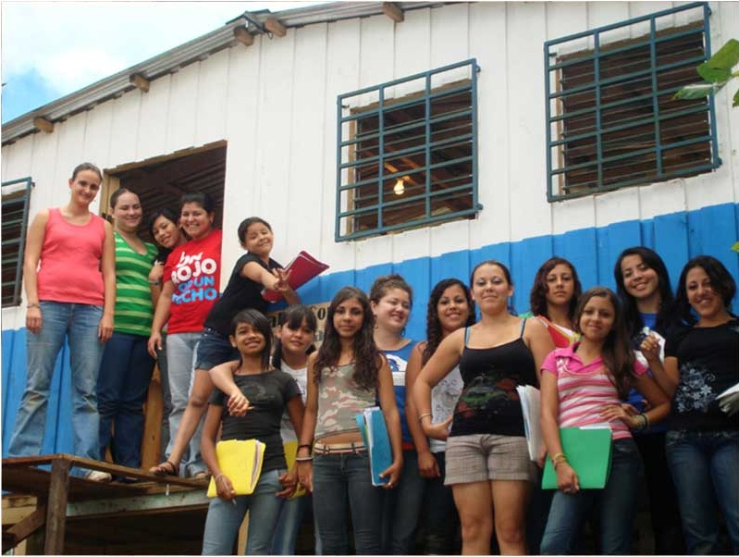
Phase 3- Implementation
Start classes
Increase participation
Activities with other programs
Notes:
Emily

Slide 20
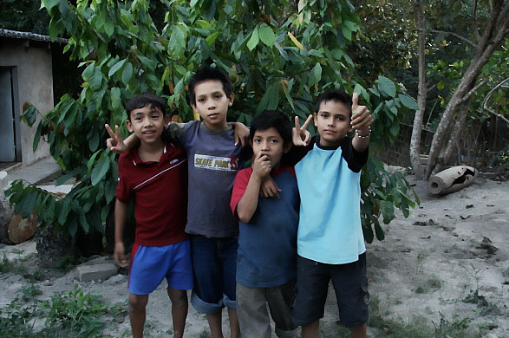
Phase 4- Revision & Expansion
Remittances
Future Peace Projects
Ex-Gang Member Visit
Awareness Campaigns
Notes:
Hallie

Slide 21
Conclusion
We hope our Community Center will combat violence and reduce gang participation, while teaching a community valuable skills in hopes of a better future.
Notes:
Marcela

Slide 22
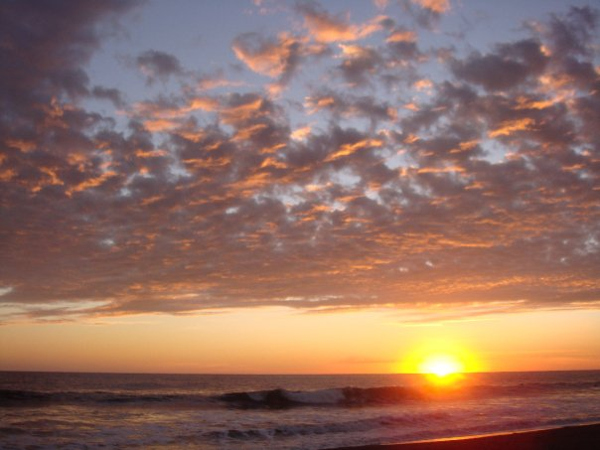
Questions?

