Slide 1
El Salvador: Background Report
Emily Gordon
Marcela Zablah
Hallie Knight Hughes

Slide 2
Presentation Outline
Basic Information
Definition of Development
Health
Education
Economy
Government Corruption
Natural Disasters
Crime

Slide 3
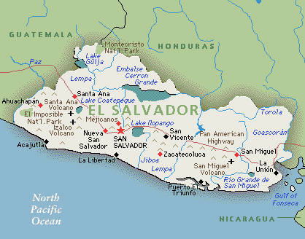
Basic Information
Population: 6,071,774
Total Area: 21,041 Sq Km
Location: Bordered by the Pacific Ocean, Guatemala and Honduras

Slide 4
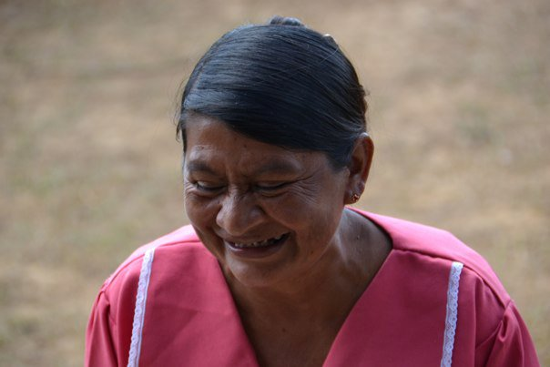
“Development should be synonymous with quality of life”

Slide 5
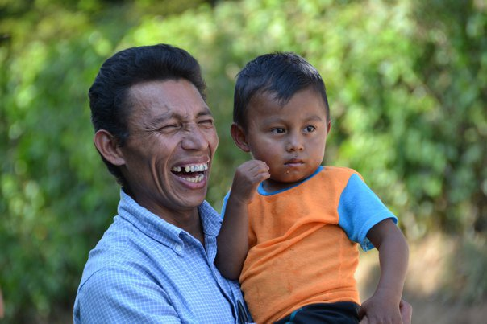
“A good quality of life means not
only having your basic needs met,
but being able to live free from
disease, hunger and corruption”

Slide 6
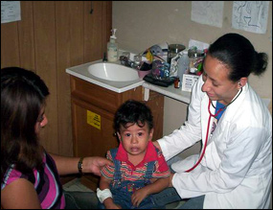
Health
An unhealthy population will be unable to work, attend school, or be productive.

Slide 8
Education
Education is the key to opportunities, innovation and all around improvement of the quality of life.

Slide 10
Most Significant Problem Areas

Slide 11
Economy

Slide 12
The One-Gap

Slide 13
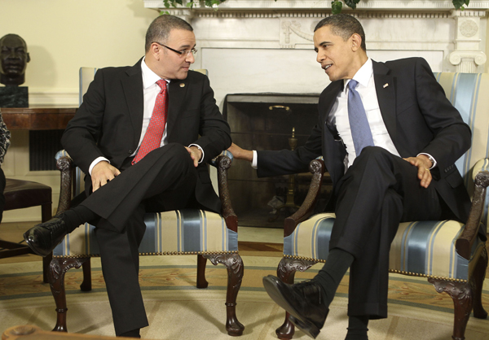
Dependency on the U.S.

Slide 14
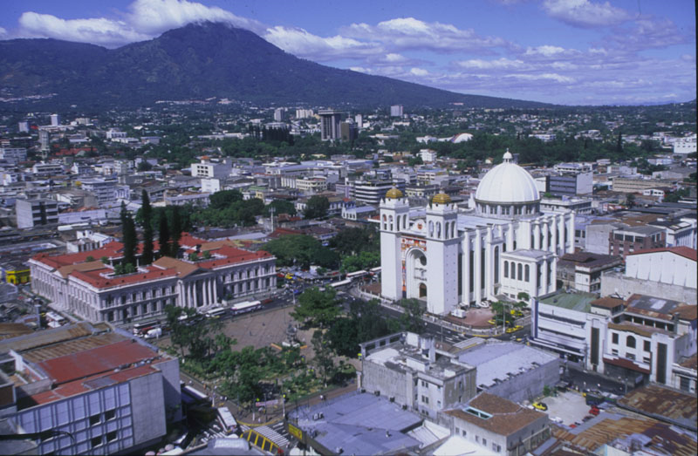
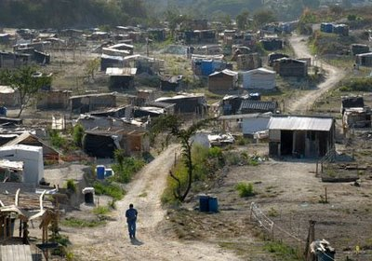
Inequality

Slide 15
Government Corruption

Slide 16
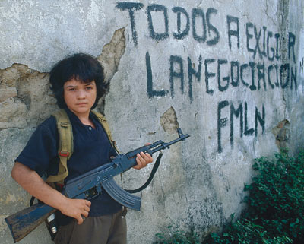

Slide 18
Natural Disasters

Slide 19
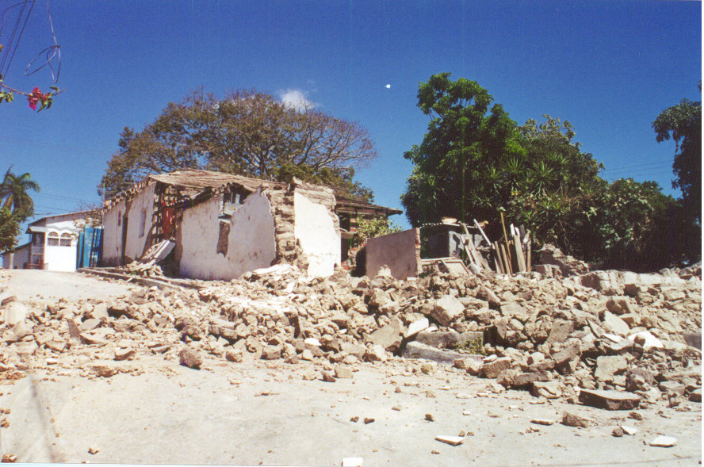

Slide 20
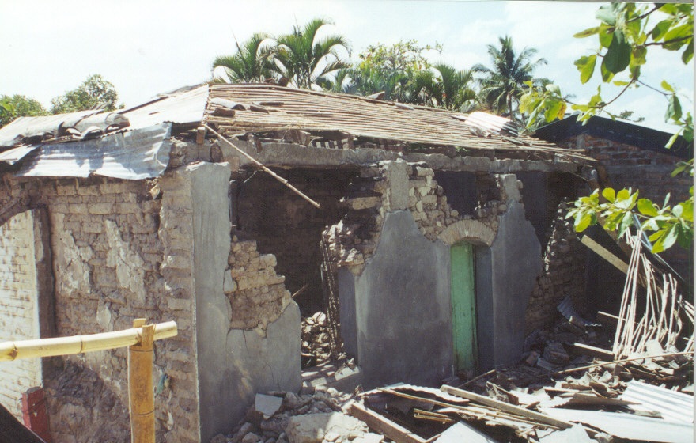
Earthquakes:
January 13: 944 deaths
February 13: 315 deaths

Slide 21
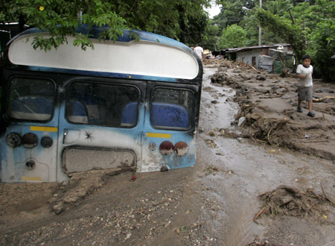
Hurricane Mitch:
239 deaths, 135 missing

Slide 23
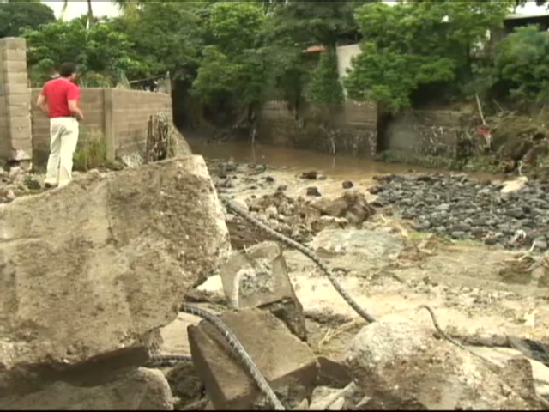
Expenses:
Hurricane Mitch = 388 million dollars
January earthquake = 1255 million dollars
February earthquake = 348.5 million dollars

Slide 24
Crime

Slide 25
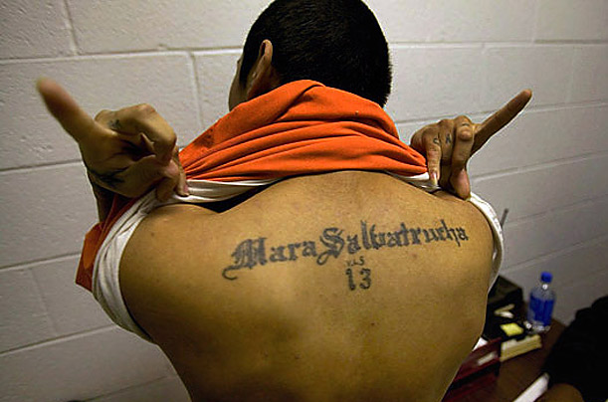

Slide 27
Conclusion
El Salvador is a country with a lot of development potential
It is being held back by its economic dependency, destructive natural disasters, government corruption, and high crime rates

Slide 28
Q and A

