Slide 1
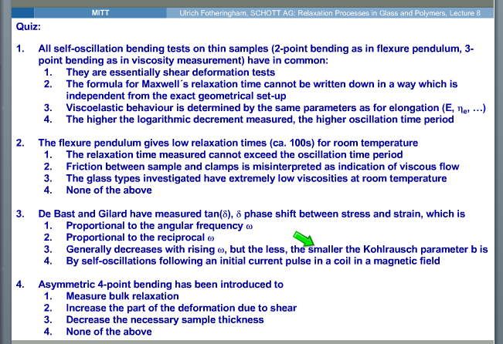
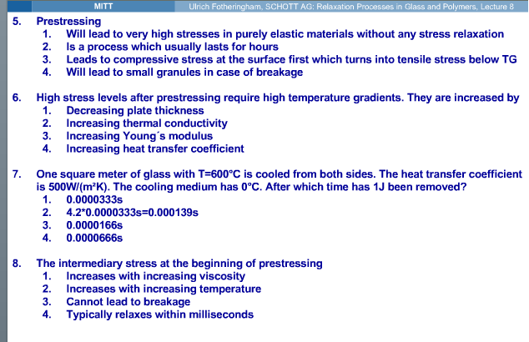
3
2
3. 3
4. 2
5. 4
6. 4
3 (needs another 0)
8. 1

