Slide 1
Playing Pool: Head and Hand Working Together
John B. Gatewood Lehigh University
SfAA/SAS Meetings in Santa Fe, NM 28 March 2024

Slide 2
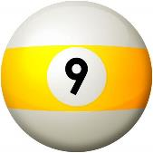
Abstract
Playing pool involves formulating plans for pocketing balls in sequence based on the layout of the balls on the table, the player’s general ‘folk model’ of physics, and his/her self-assessment of the ability to make particular shots. Then, one has to execute the plan.
But, each pocketed shot alters the subsequent layout, such that often one has to make a new plan if the cue ball did not end up where anticipated. This presentation uses the example of 9-Ball to illustrate how the ‘head game’ of pool and acquired physical skills are tightly interrelated in an everyday activity.

Slide 3
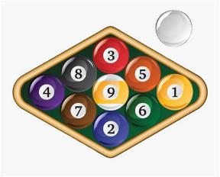
Outline
Conceptual Framework – Active Cognition
Salmon Seining & Bartending (brief comparison cases)
Equipment and Rules for “Pocket” 9-Ball
Playing Pool: Head and Hand Working Together
Concluding Remarks

Slide 4
1. Conceptual Framework – Cognition
A c t i v e

Slide 5
Everyday activities generally involve multiple kinds and scales of cognitive structures that are temporally integrated with the on-going flow of actions.
My interest in highly sequenced but only slightly repetitive physical activities comes from several intense, non-academic experiences, e.g.:
Playing high school football … mid-1960s
Bartending for two to three years at University of Illinois Faculty Center … mid-1970s
Working on Southeast Alaskan salmon seine boats for three seasons … 1975, 1976, 1977
Playing pool … the past 50+ years [and my main example today]

Slide 6
All such activities involve a ‘head game’ along with skilled physical actions in which both sequencing and timing are critical aspects. And, in our everyday behavior, normal humans manage to integrate our mental and physical activities.
But, how does all the cognitive stuff underlie, guide, coordinate, and mesh with one’s behavior in real time?
A first step in addressing this BIG QUESTION is to take seriously the fact that all “knowledge structures” have careers in time …
the time it takes to construct/learn things
characteristic trajectories of duration when activated
spatiotemporal distributions within and among populations

Slide 7
Methodology: My descriptions are based mostly on introspection to identify the salient stages or steps that are typically part of the activity, whether lexicalized or not.
Rationale: If you routinely do an activity yourself, it is pretty easy to identify the times when your attention remains tightly focused, when it is diffusely monitoring, and when it is going through a re-orientation … even if no one usually talks about such things.
Caveat: There is no magic window into people’s minds, even our own, and one’s “key informant” might be insight-deficient. But, conversations with and observations of other experts can confirm general features of one’s introspective account as well as reveal idiosyncrasies.

Slide 8
My talk today is mainly about playing pool, but I’ll begin by briefly discussing salmon seining and bartending (things I’ve written about before).
In general terms, playing pool has much in common with these other activities. But, pool inherently involves many more contingencies such that quickly re-formulating plans is both essential and expected rather than unusual and sporadic.

Slide 9
2. Salmon Seining & Bartending
( brief comparison cases )

Slide 10
Southeast Alaskan Salmon Seining ( highly sequenced routine, complex division of labor )

Slide 11
Bartending ( recipe templates, ad hoc production plans, bilateral independence )

Slide 12
3. Equipment and Rules for “Pocket” 9-Ball

Slide 13
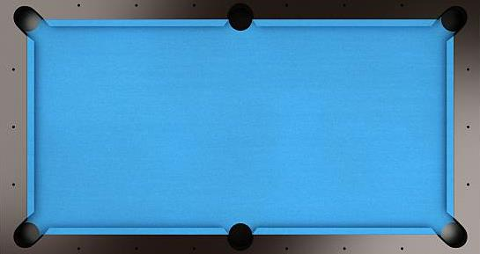
Standard Pool Table & Ball Dimensions
Table: 9-feet x 4½-feet … playing surface: 100” x 50”
Balls: 2¼-inches diameter & weight ~5.8 ounces
50”
100”

Slide 14
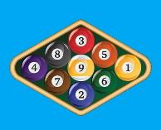
Layout to Begin Game: Nine numbered balls (in diamond-shaped rack) … 1-ball on the spot, 9-ball in center, and cue ball behind breaking line.
Player 2’s pocket
“neutral” pockets
Player 1’s pocket

Slide 15
Basic Rules for “Pocket” 9-Ball
Cue ball must hit the lowest-numbered ball on the table before hitting any other ball (a “good hit”).
Players do not have to “call their shots”.
Must pocket some object ball to continue shooting.
Exception: If the 9-ball drops into a “neutral” pocket, it is immediately placed on the spot. But, player continues shooting only if some other ball was made as well.
“Scratching” ends a player’s turn AND opponent gets “cue ball in hand”.
Scratches = (a) cue ball drops into a pocket or any ball flies off table, (b) cue ball doesn’t hit the lowest-numbered ball on table first, or (c) no ball hits a rail or drops into a pocket
WINNING: Player who makes the 9-ball in “own” pocket wins, but if player makes the 9-ball in opponent’s pocket, opponent wins.

Slide 16
4. Playing Pool: Head and Hand Working Together

Slide 17
--- The HEAD Game ---
In broad terms, the ‘head game’ in pool involves three very different kinds of knowledge / mental abilities:
General Pool Knowledge (“folk physics”: theoretically, how balls will behave after colliding with other balls or the table’s rails)
Analyzing Layouts of Balls During Game
Self-Assessment of Shot-Making Skills
Each of these is quasi-independent of the other two.
E.g., Sally has excellent General Pool Knowledge and is pretty good at Analyzing Layouts, but has a somewhat inflated self-assessment of her Shot-Making Skills.

Slide 18
(a) General Pool Knowledge
Euclidean Geometry (frictionless “bounce” physics)
Line of centers … direction object ball will go after collision
Tangent line … direction cue ball will go after collision
Aiming line … center of cue ball to center of imagined “ghost ball” adjacent to object ball
Angle of inflection ≡ Angle of reflection … direction a ball will go after colliding with a rail (important when doing “bank” shots or “kick” shots)
Momentum Physics with Friction
VELOCITY matters (speed + direction) … how far balls roll depends on the force put on the cue ball and the angle at which cue ball collides with object balls
SPIN on cue ball matters … “English” introduces angular momentum as well as linear momentum, and affects how the cue ball will behave after colliding with an object ball or rail

Slide 19
Key Euclidean Geometry “Lines”
Tangent Line
“Ghost” Ball
Aiming Line
Line of Centers

Slide 20
( some general pool knowledge websites )
https://www.youtube.com/watch?v=qzjousgGLjU excellent overall instructional video (~1 hr 6 min.)
https://billiards.colostate.edu/ many instructional videos
https://www.livea%bout.com/billiards-4688102 many instructional videos
https://www.youtube.com/watch?v=KL0W45AkNMo cue ball “folk physics” (~12 min.)
https://www.youtube.com/watch?v=ErFP7VmNbGk cue ball physics by MIT Professors (~25 min.)

Slide 21
(b) Analyzing Layouts of Balls During Game
Each game begins with the object balls racked in a diamond shape with the 1-ball in front and 9-ball in the center.
The “break shot” scatters the balls into what is likely a unique configuration.
And, after each shot, the balls come to rest in yet another perhaps unique configuration.
Thus, players are ALWAYS analyzing the current situation and then devising or revising their plans.

Slide 22
(c) Self-Assessment of Shot-Making Skills
Generally, how good am I at making shots ?
“straight-in” shots
“cut” shots
“bank” shots (1-rail … 2-rails … 3-rails)
“kick” shots (rail-first)
Generally, how good am I at controlling cue ball’s position (using correct speed and “English”) ?
How am I playing today ?

Slide 23
* * * Demonstration / Example * * *
Now would be the time to step over to the pool table and DEMONSTRATE how my (a) general pool knowledge, (b) analyses of the changing layout of balls on the table, and (c) self-assessment of shot-making skills interact with one another as a game progresses.
But, I don’t see the pool table I requested !!
So, I’ll just talk about Analyzing Layouts – a very “pool specific” matter – using one example: a layout with just the last three object balls (7, 8, and 9) in a game of Pocket 9-Ball.

Slide 24
SITUATION: Player 1’s turn with 7-, 8-, and 9-ball left on the table
8
cue ball
7
“own”
pocket
9
What “run-out” PLANS come to mind?

Slide 25
Pocketing 7-ball in lower right corner is a no-brainer, but getting
“good position” for 8-ball is a bit tricky given where the 9-ball is.
Decision: Shoot the 7-ball with low-right spin to get position for 8-ball.

Slide 26
Pocketing 8-ball in upper right corner is also a no-brainer, but getting
position for a realistic 9-ball shot involves a critical choice
You want to play CONSERVATIVELY or AGGRESSIVELY ??

Slide 27
CONSERVATIVE PLAY: Shoot the 8-ball gently with no spin
to get position for “three-rail bank” shot on 9-ball

Slide 28
Conservative 8-ball shot and position were successful, but now you have a difficult bank shot …
Wow, a great three-rail bank shot to win !!

Slide 29
AGGRESSIVE PLAY: Shoot the 8-ball with lots of low-left spin
( trying to get position for easy “straight in” on 9-ball )
Wow, GREAT POSITION after making the 8-ball !!

Slide 30
So, shoot the easy straight-in 9-ball to “own” pocket and WIN

Slide 31
Other CONSIDERATIONS given initial layout …
“own”
pocket
What are CONSEQUENCES OF MISSING shots in each “plan” ??

Slide 32
Okay. I’ve explained two analyses (Plans) with respect to one situation involving three object balls… but, that explanation took several minutes! AND, I left out the actual processing steps whereby the two plans were formulated and decisions concerning shot mechanics evaluated.
So, this time, I’ll analyze the same situation, but following the sequential procedures I actually use when playing pool.

Slide 33
“my”
pocket
{ talk through analysis … while using pointer }

Slide 34
Now you’ve heard a bit more about how players sequentially analyze a given situation.
KEY: Identify the biggest “challenge” presented by the layout and think of solutions to that … do not simply begin with the 1st shot, then the 2nd, etc.
BACK-ENGINEERING reduces the number of possibilities one has to evaluate !
NOTE: When playing pool, the real time cognitive processing of situations and deciding among options occur much, much faster… usually, just a few seconds!

Slide 35
Key Points of the Head Game Example
Even with just three object balls, players can usually see more than one way to run-out; thus, choices have to be made among different “plans”.
In the example, both the CONSERVATIVE and the AGGRESSIVE plans involved a single “difficult shot” … so how does one decide among them?
Key considerations when deciding among alternative plans:
Degree of difficulty of the “difficult shot”
Player’s confidence with respect to the “difficult shot”
Likely consequences of missing planned shots, i.e., what situations would be left for the opponent

Slide 36
--- The HAND Game ---
Formulating good plans rests almost entirely on mental activities, but successfully executing plans is another matter entirely.
Making shots involves an array of acquired and coordinated physical skills … stance, bridge, stroke, focused attention, keeping eyes on target, avoiding nervous tension, etc.
And, developing the various physical skills takes practice-practice-practice… (although coaching by a good player does help avoid bad habits).

Slide 37
Once a decision is made concerning the Plan, mental activities shift from analysis mode to focused concentration on the physical actions necessary to execute the upcoming shot.
Get proper stance for the shot with respect to aiming line
Align tip of cue to position on cue ball for the shot’s appropriate “English”
Visualize the “ghost ball” point of aim vis-à-vis object ball
Warm-up stokes to get arm muscles prepared for the appropriate force to be applied to cue ball
Then, while looking at the imagined “ghost ball” point of aim (not at the cue ball itself), s t r o k e the cue ball

Slide 38
--- Synopsis ---
To excel at pool, you’ve got to know what shots to attempt in what order, but it is only with practice that you will improve your physical skills enough to execute well-formulated plans.
Head and Hand have to work together.

Slide 39
5. Concluding Remarks

Slide 40
Everyday activities generally involve multiple kinds and scales of cognitive structures that are temporally integrated with the on-going flow of actions.
The cognitive structures involved in the ‘head game’ of pool are active before and after every shot, and involve three broad categories:
General pool knowledge (a.k.a., “folk physics”)
Applying one’s “folk physics” understanding to formulate situation-specific plans for running balls
Self-assessment of shot-making skills

Slide 41
But, analyzing situations and making plans is not the only time conscious/semi-conscious mental activities are involved.
Other kinds of mental activities are occurring contemporaneously with physical actions when shooting shots:
Concentration (attention focused on pool table, relaxing one’s body, and keeping a calm state of mind)
Maintaining disciplined visual attention when aiming
Kinesthetic elements of s t r o k i n g the cue ball

Slide 42
GENERAL POINTS …
Knowledge structures –all shapes and sizes – have characteristic durations when activated, and “thinking” takes time.
Thus, it’s time [sic] we include temporality in studies of cognition (minimally, the sequencing of cognitive activities). e.g., How do different kinds of knowledge structures “behave” in everyday life?
In short, I hope cognitive anthropologists will pay more attention to the polyphony and flow of thoughts , i.e., focus on active cognition rather than static depictions of ‘what is known’.

Slide 43
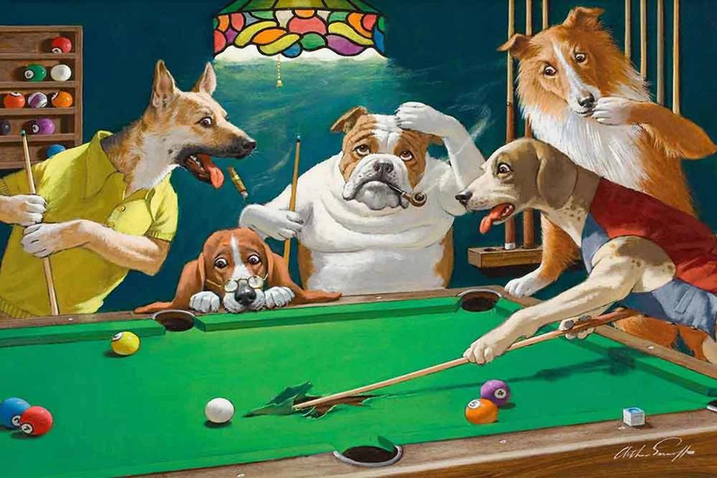
F i n i s
Some players can’t help “dogging” their shots.

Slide 44
Other Works …
SALMON SEINING:
Gatewood, John B. (1978) Fishing, Memory, and the Stability of Culture Complexes. Ph.D. dissertation, University of Illinois at Urbana-Champaign.
Gatewood, John B. (1985) Actions speak louder than words. In Janet Doughtery, ed., Directions in Cognitive Anthropology, pp. 199-219. University of Illinois Press.
BARTENDING:
Gatewood, John B. (In Press) Thinking while doing: Active cognition in bartending. In Giovanni Bennardo, Victor de Munck, and Stephen Christomalis, eds., Cognition In and Out of the Mind: Cultural Models Theory. Palgrave Macmillan.
------------------------------------------------------------------------------
COORDINATION OF BEHAVIOR:
Gatewood, John B. and Rosenwein, Robert (1981) Interactional synchrony: Genuine or spurious? A critique of recent research. Journal of Nonverbal Behavior 6(1): 12-29.

