Slide 1
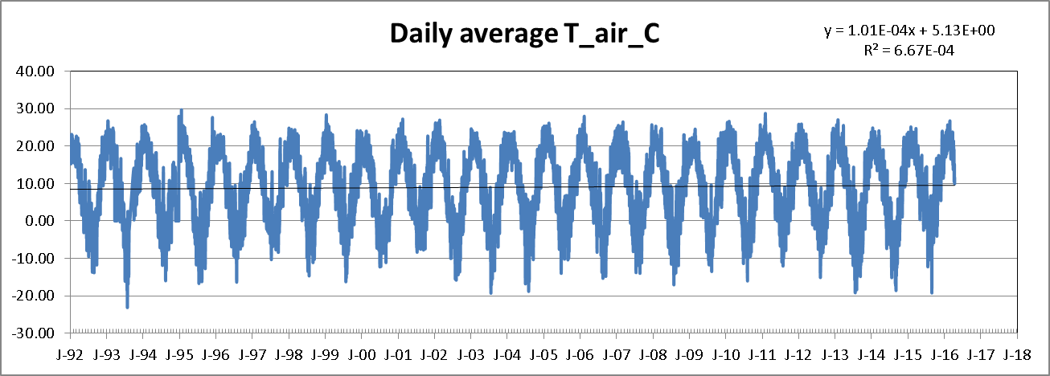
Lacawac daily average air temperatures

Slide 2
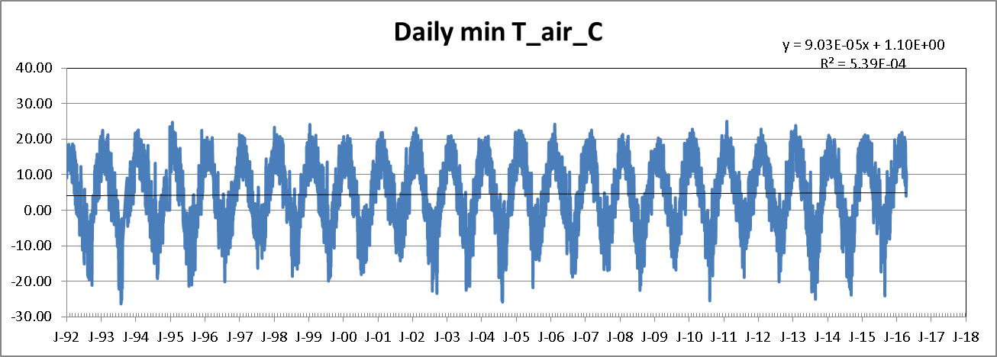
Lacawac daily minimum air temperatures

Slide 3
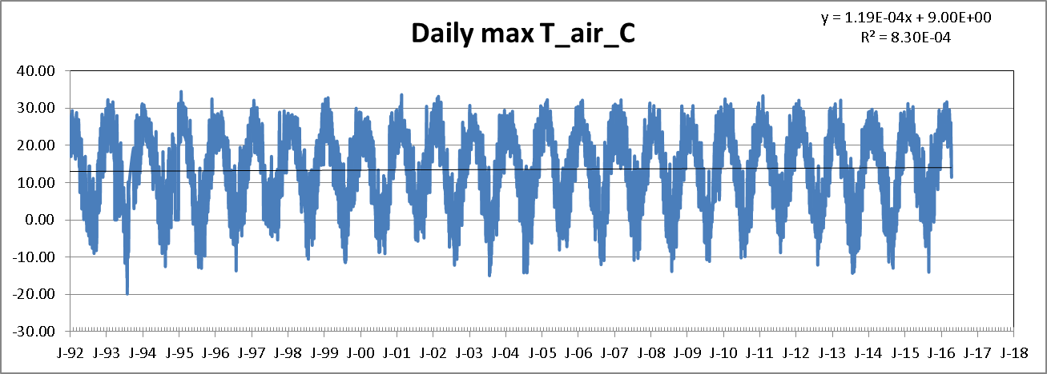
Lacawac daily maximum air temperatures

Slide 4
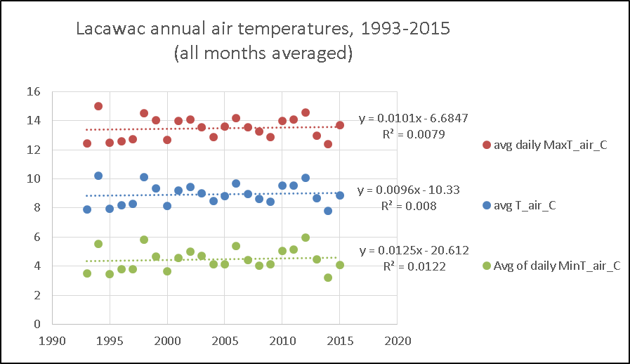

Slide 5
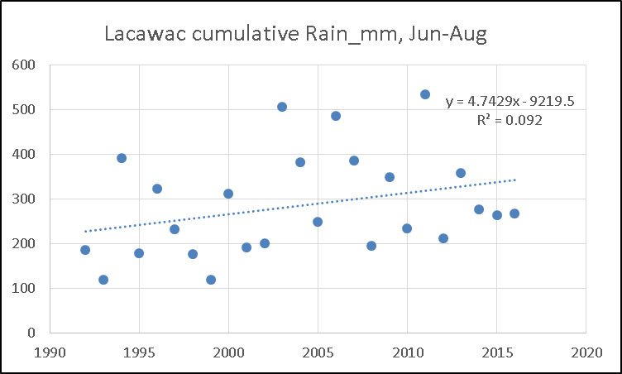

Slide 6
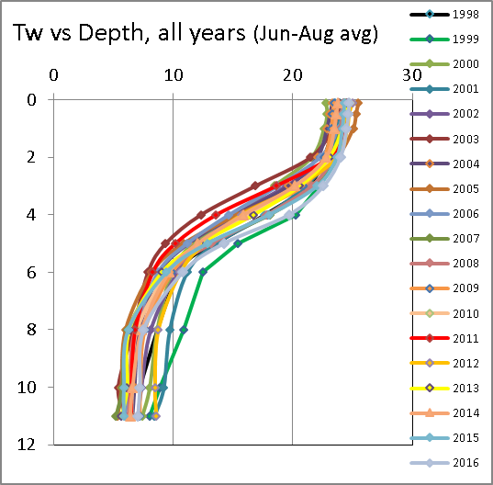
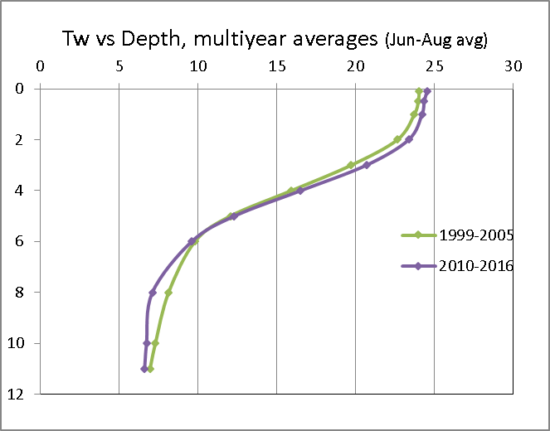
Lacawac average of daily Tw’s (June, July, August combined)
Temporal Trend is warming at surface and cooling in hypolimnion. Our research has shown this is related to a trend for increasing color from DOC in the lake absorbing more solar heat near the surface. DOC color is likely increasing because of rising precipitation, but declining acid deposition may also contribute.

